Slide 1
Acquiring, Processing and Displaying JWST NIRCam Images
Max Oakes

Slide 2
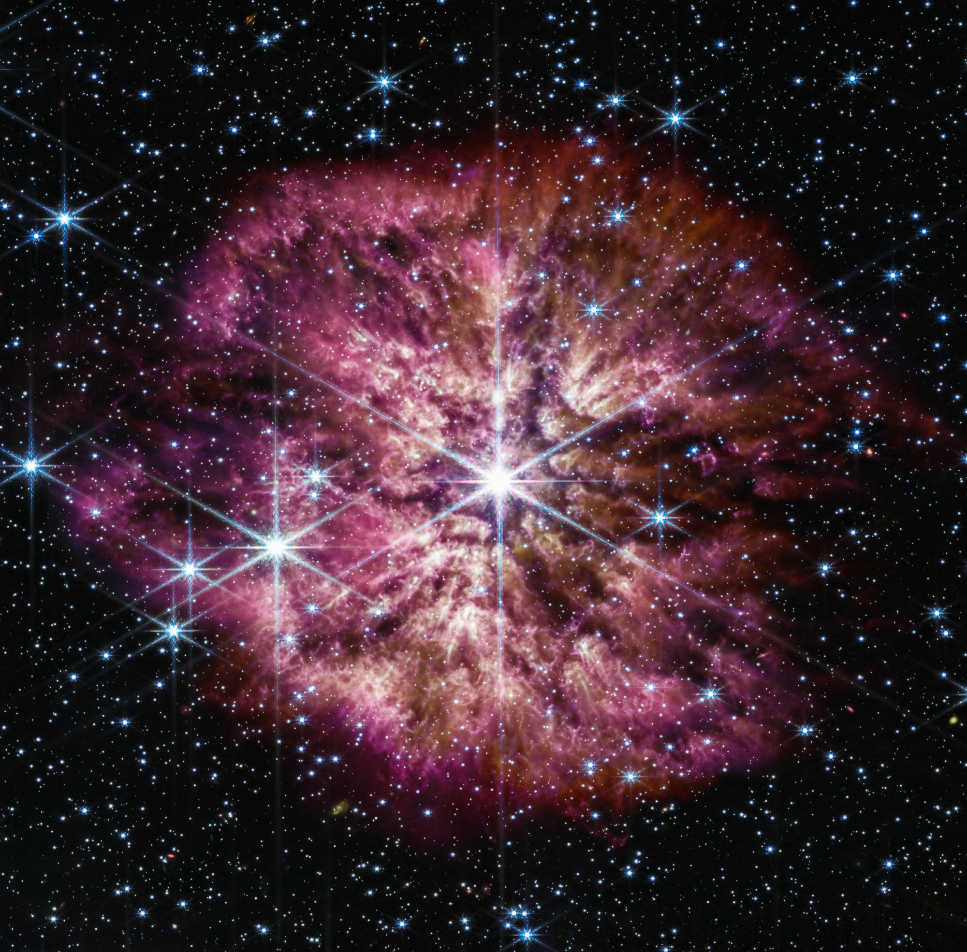
Project Overview
Automate the processing pipeline of JWST NIRCam image data
Automatically download the data given search parameters
Perform any needed processing to the images to make them ‘cleaner’
Attempt to combine any data and display the resulting image to the same caliber as the ones released by NASA
All done via a single Python script
Images released by NASA are processed by hand by multiple artists via photo editing software
Use FITS Liberator to open and level-adjust images
Photoshop to combine and enhance
WR 124
Credit: NASA via
https://www.nasa.gov/feature/goddard/2023/nasa-s-webb-telescope-captures-rarely-seen-prelude-to-supernova

Slide 3
Background

Slide 4
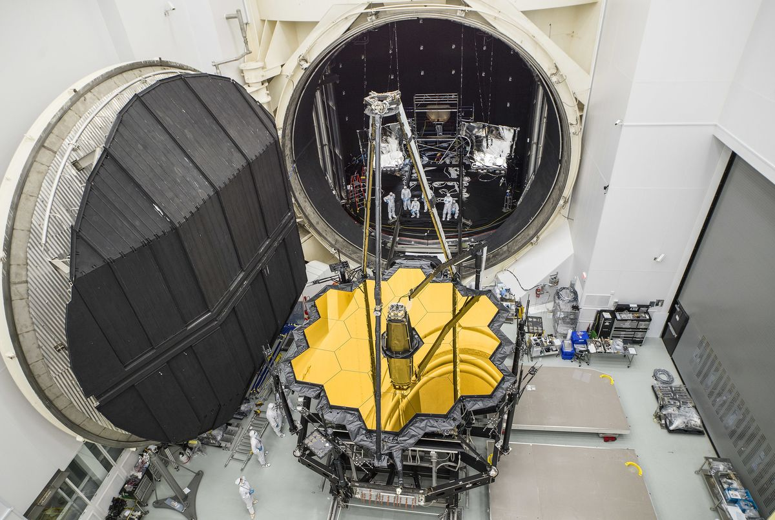
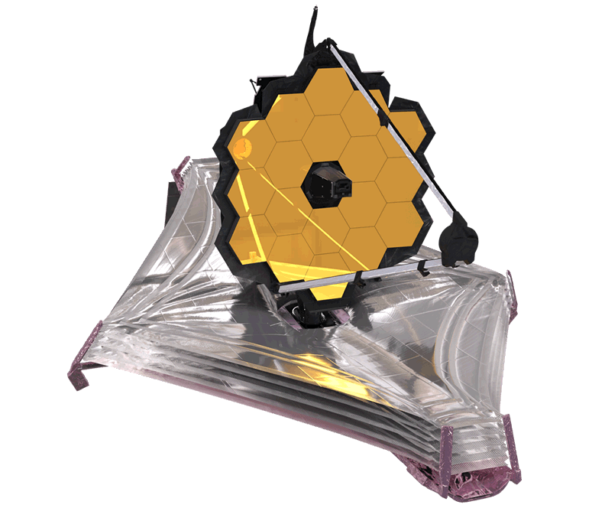
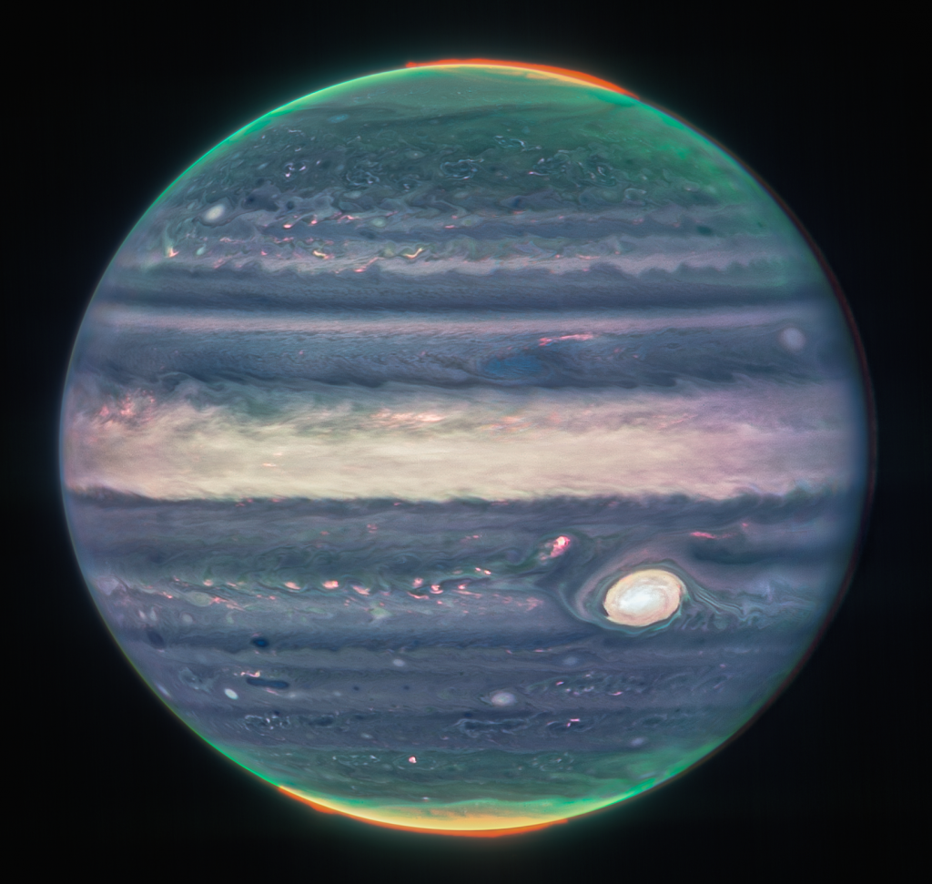
James Webb Space Telescope
Launched on December 25, 2021
Successor to Hubble Space Telescope
Mission to examine every phase of cosmic history
Primary goals:
Use sensitive infrared imaging to see first stars and the faintest of galaxies
See through clouds of dust and gas to observe how planetary systems are born
Study atmospheres of extrasolar planets in hopes of finding building blocks of life
Webb NIRCam composite image of Jupiter from three filters – F360M (red), F212N (yellow-green), and F150W2 (cyan) – and alignment due to the planet’s rotation. Credit: NASA, ESA, CSA, Jupiter ERS Team; image processing by Judy Schmidt. Via
https://blogs.nasa.gov/webb/2022/08/22/webbs-jupiter-images-showcase-auroras-hazes/

Slide 5
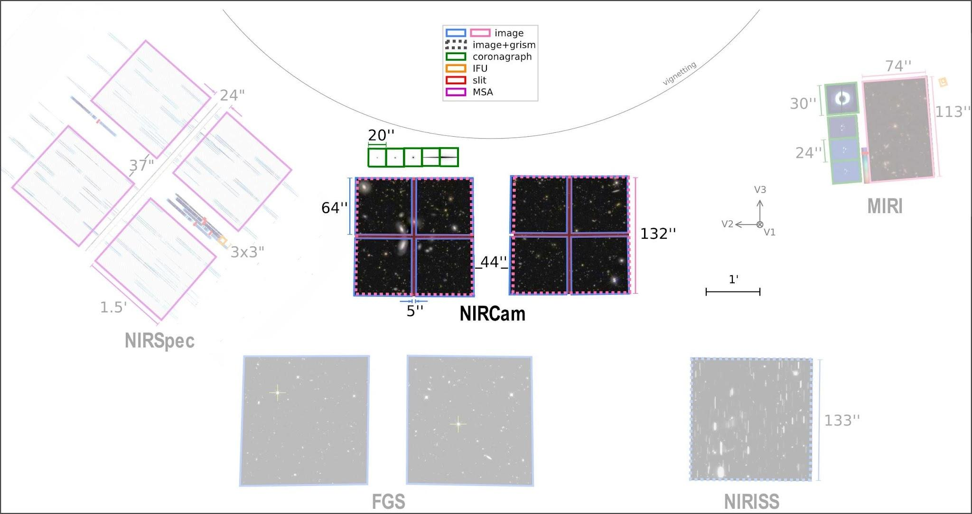
James Webb Space Telescope Imaging Instruments
MIRI Imager
Imaging Range: 5.6 - 25.5µm
9 filters
FOV: 1.7 x 1.3 arcmin
NIRCam Infrared Camera
Imaging Range: 0.6 - 5.0 μm
29 available filters
FOV: 9.7 arcmin² = 0.000006253 steradian
Offers occlusion masks
NIRISS Imaging
Range: 0.8 - 2.5µm
FOV: 2.2 arcmin²
NIRSPEC Spectroscopy
Range: 0.6 - 5.3µm
FOV: 2.4 x 3.6 arcmin
JWST's Fine Guidance Sensor (FGS) provides data for science attitude determination, fine pointing, and attitude stabilization using guide stars in the JWST focal plane.

Slide 6
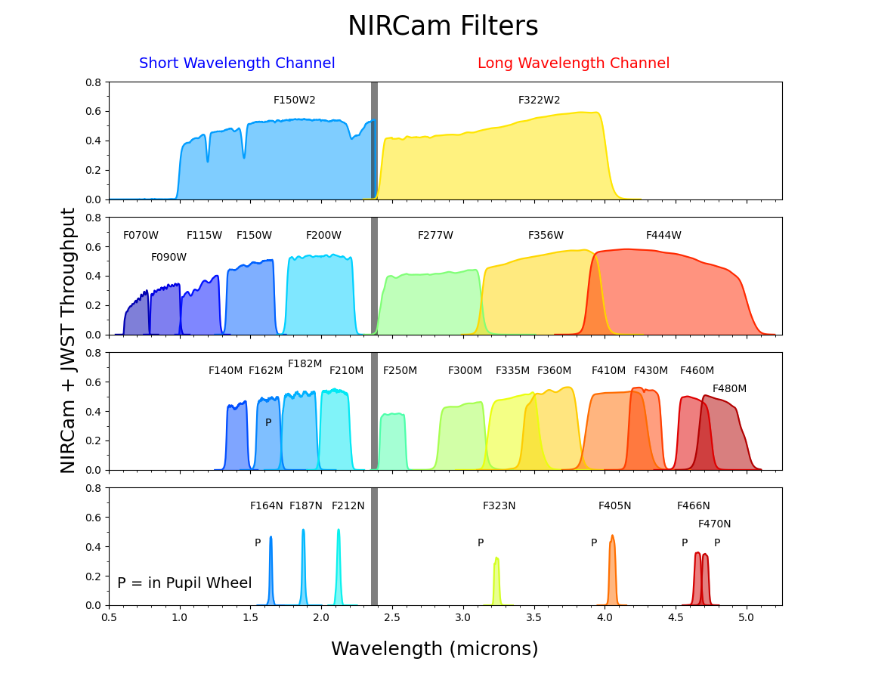
James Webb Space Telescope Filters
Through all instruments on all modes:
0.6 − 28.8µm
For NIRCam only:
Small bandwidth: 0.6 - 2.3µm
Large bandwidth: 2.4 - 5.0µm

Slide 7
FITS File Format
Used to store astronomical data
Each filter exposure image is in one FITS file
Consists of HDUs (Header + Data units)
Each header unit can contain a table data structure that resembles a dictionary
KEYNAME = value / comment string
Also can contain a data unit
N-dimensional array of one data type (signed, unsigned ints, or floats)

Slide 8
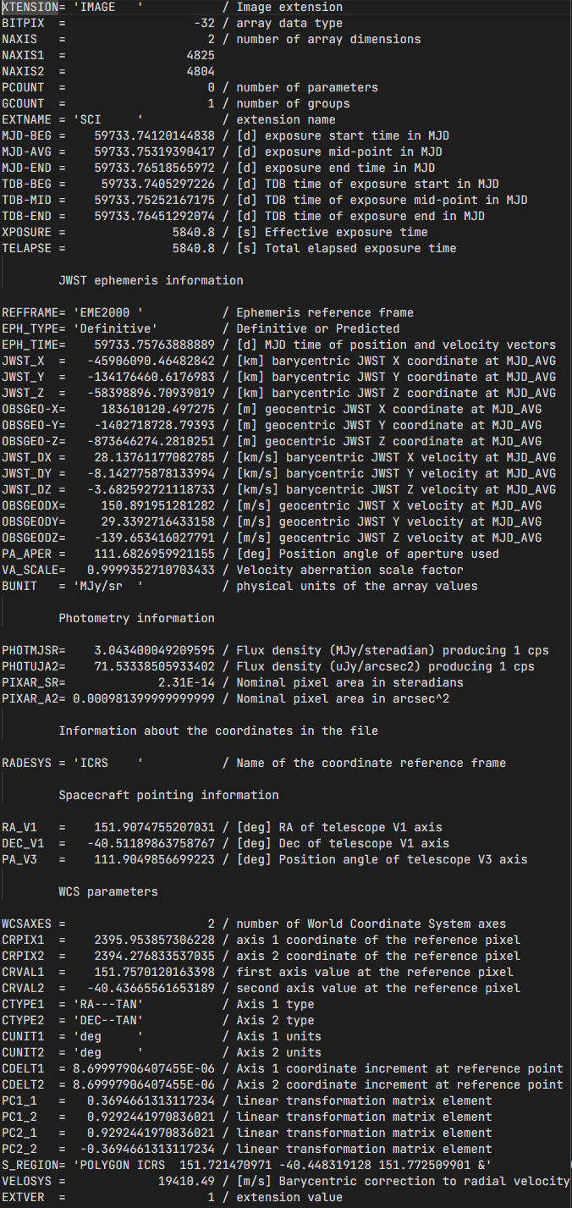
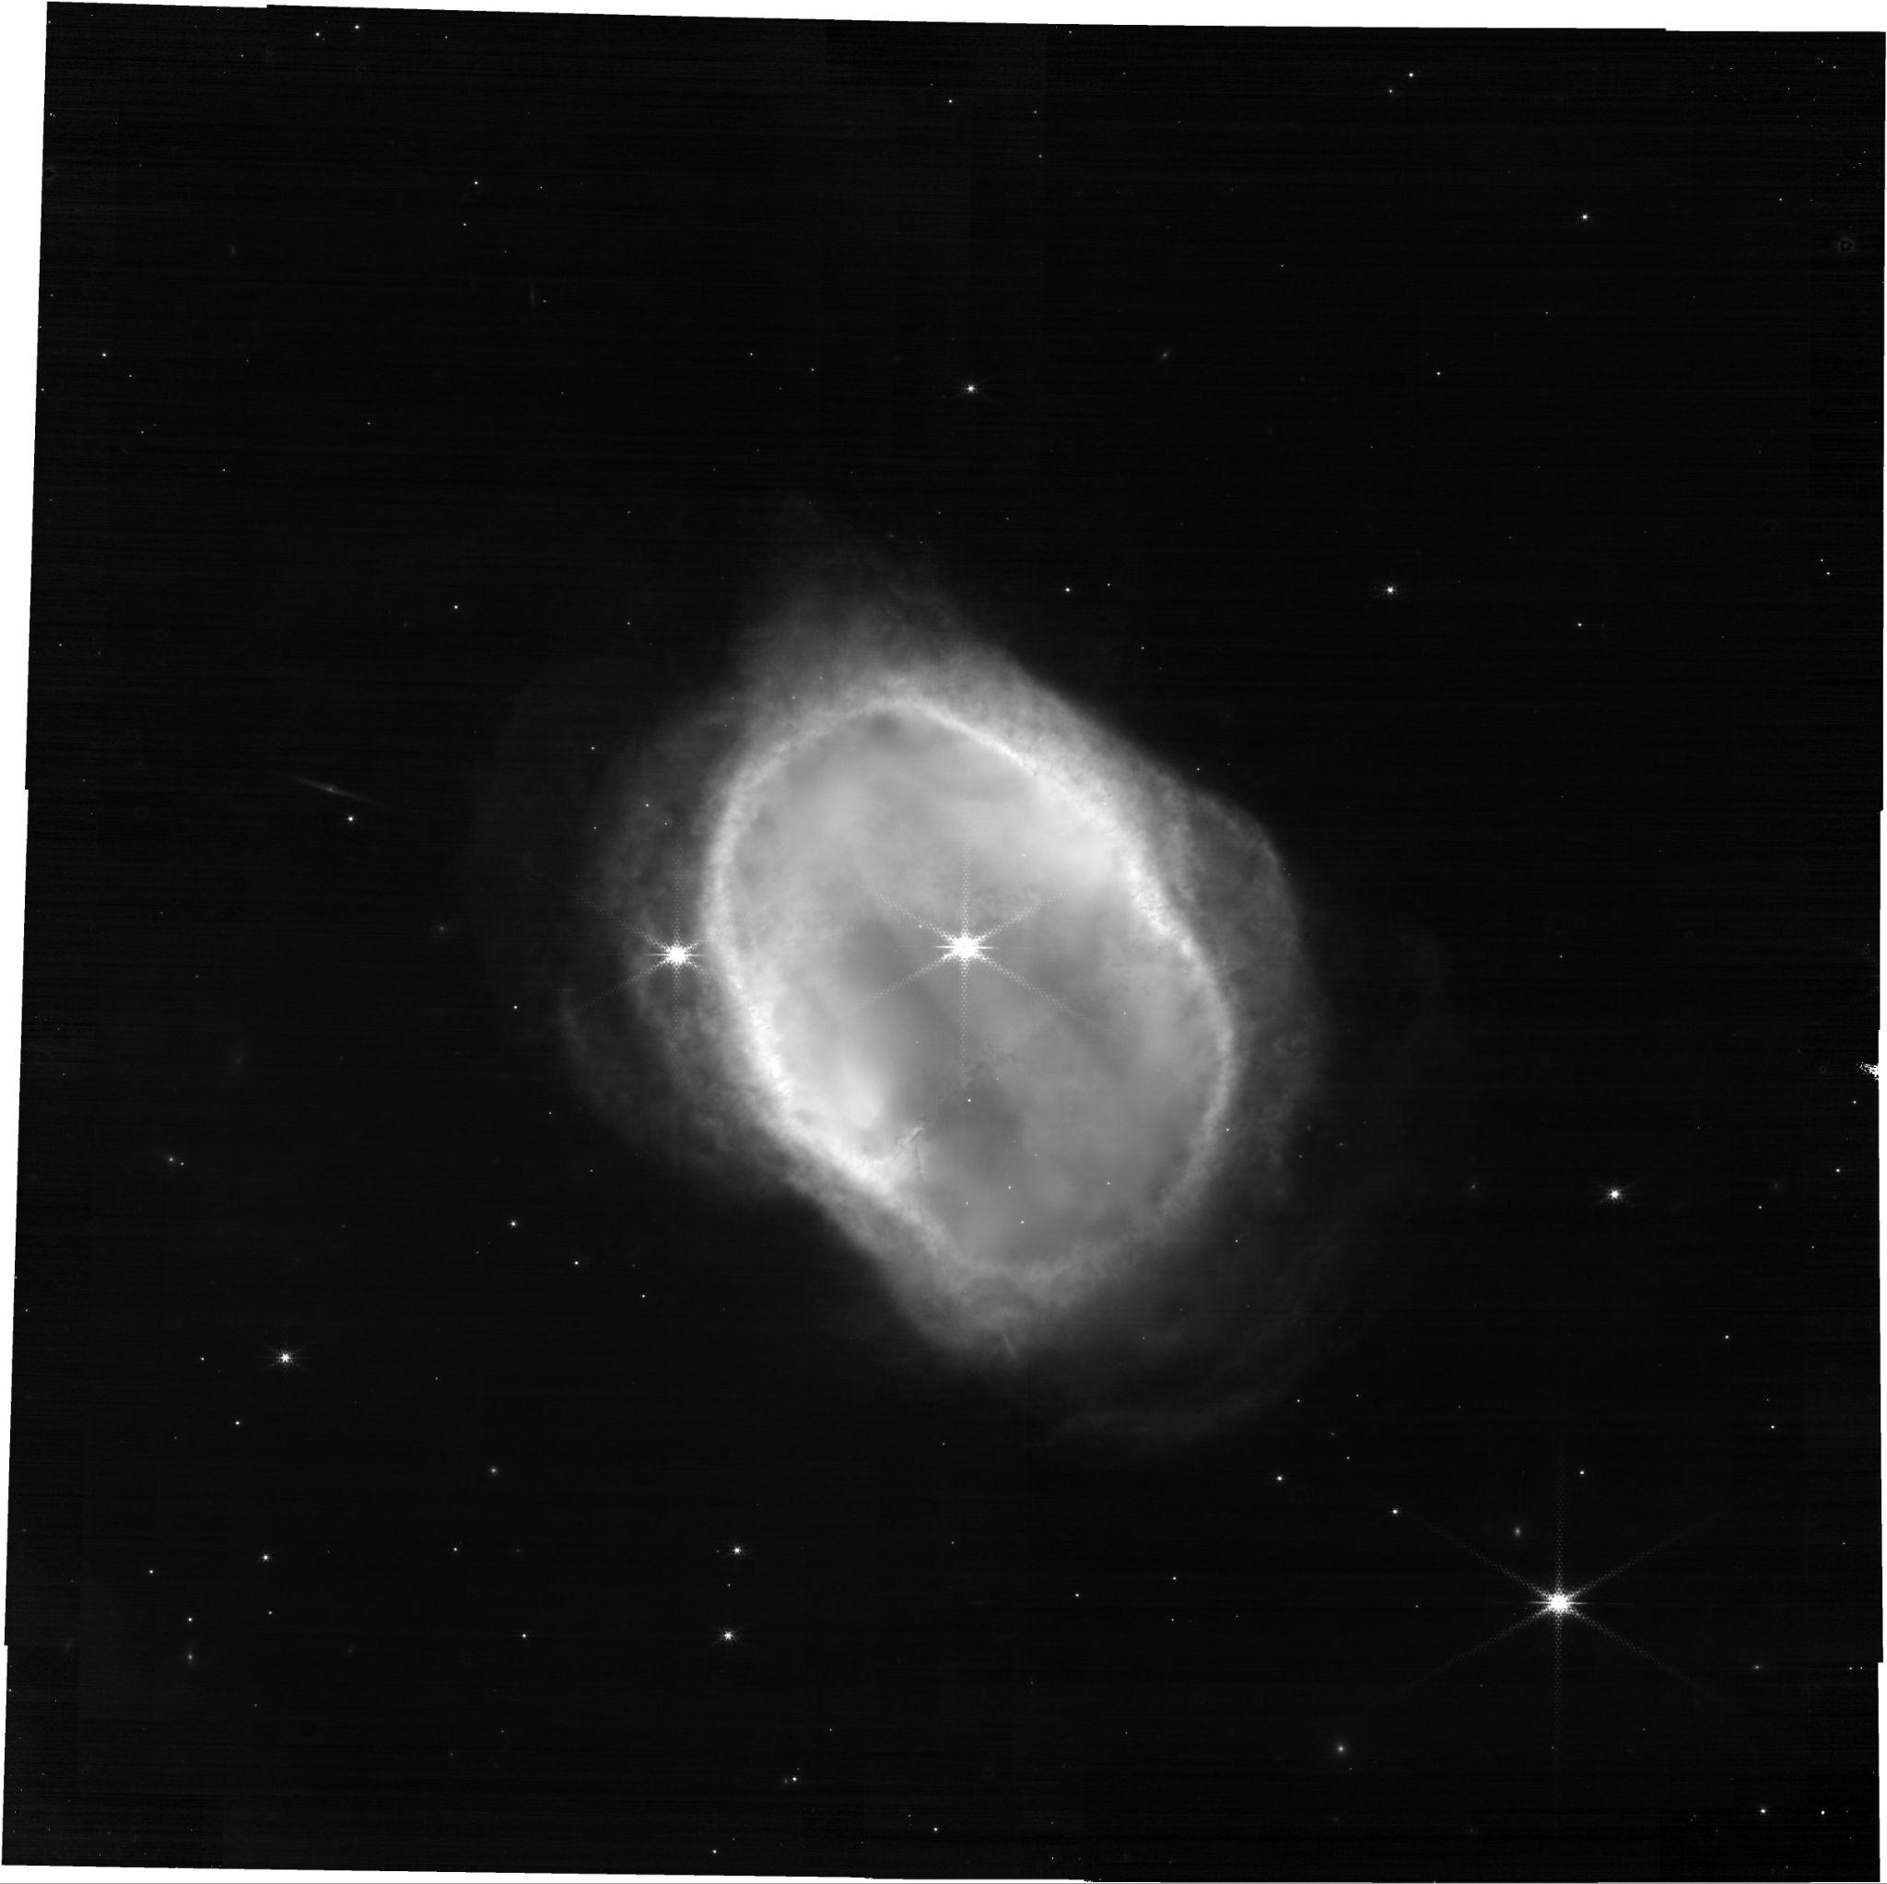
FITS File Format and Preview Image
Example printout of the header records of a FITS file
Preview image that comes with each FITS file: represents the data unit

Slide 9
Methodology

Slide 10
Downloading the Data
Astroquery library allows for querying and downloading from the MAST archive
Query Mode:
Allow the user to query for a target, mission title or proposal ID
Automatically runs a query to the MAST archive for stage 3 data for JWST NIRCam, then writes a CSV to the disk
Run Mode:
Enter a proposal ID, then automatically download all associated FITS files for that mission and reference those files in the future
Images are put into a python dictionary with the filter as the key
(filter name, np array)

Slide 11
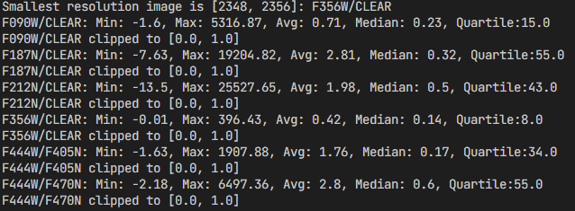
Processing the Data: Value Clamping
Clamp the brightness
All images are high dynamic range between ~0 and upwards of >10000
Find the 99.9% highest value, and use that as the upper clamp
Then normalize them to between 0 and 1 as floats
Need a reasonable range for when the image is converted to color

Slide 12
Processing the Data: Alignment
Each filter image is a different resolution, need to make them the same to proceed
Naive way:
Assume that the images all show the same exact spatial area
Find the smallest resolution of the images, then resize all images to that size
Pad the images if needed so there is no stretching
Result:
The images are not aligned
If the captures are done around the same time, they have about the same rotation
If they are not the same rotation, the spacecraft orientation can be referenced to correct the rotation

Slide 13
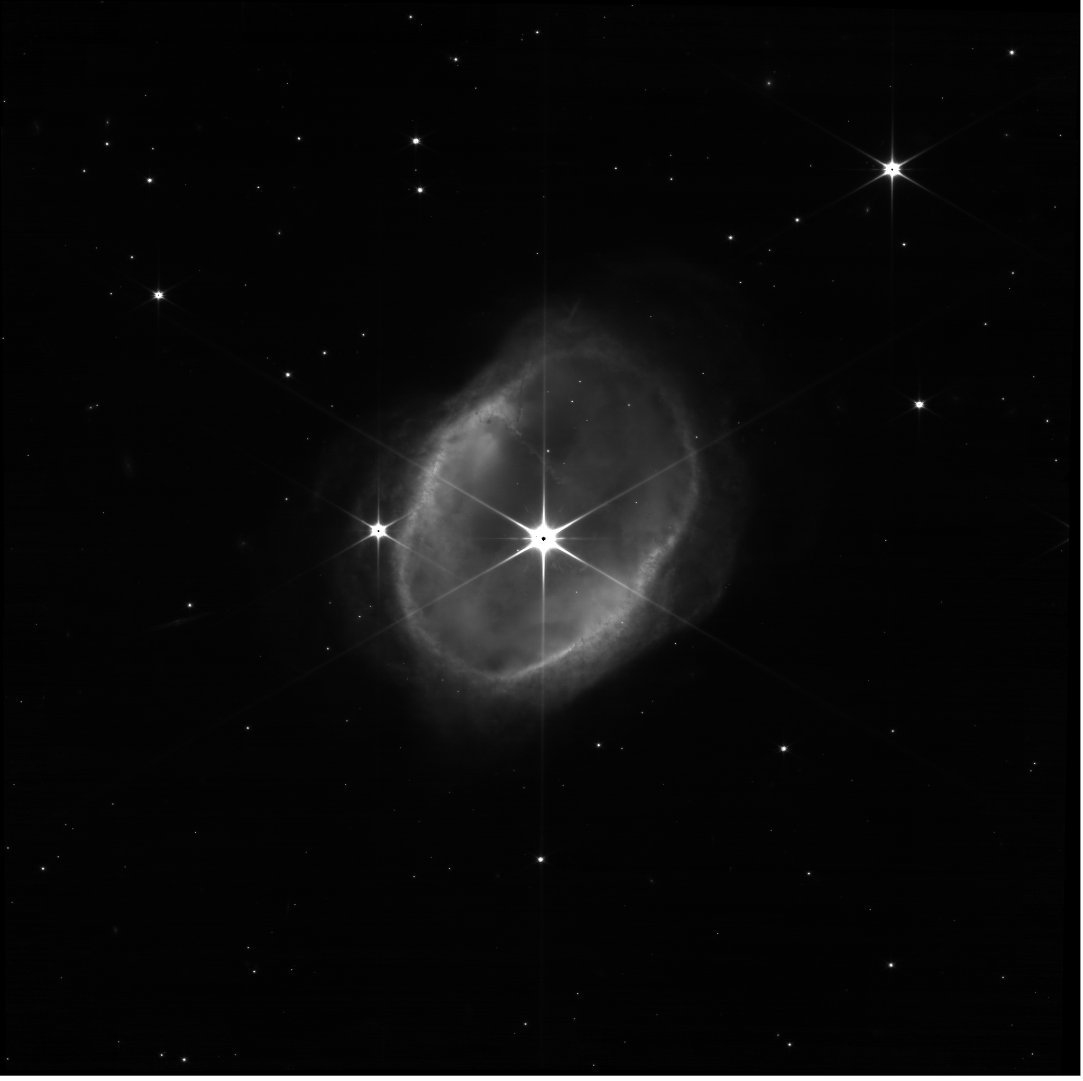
Filter: F090W, clear

Slide 14
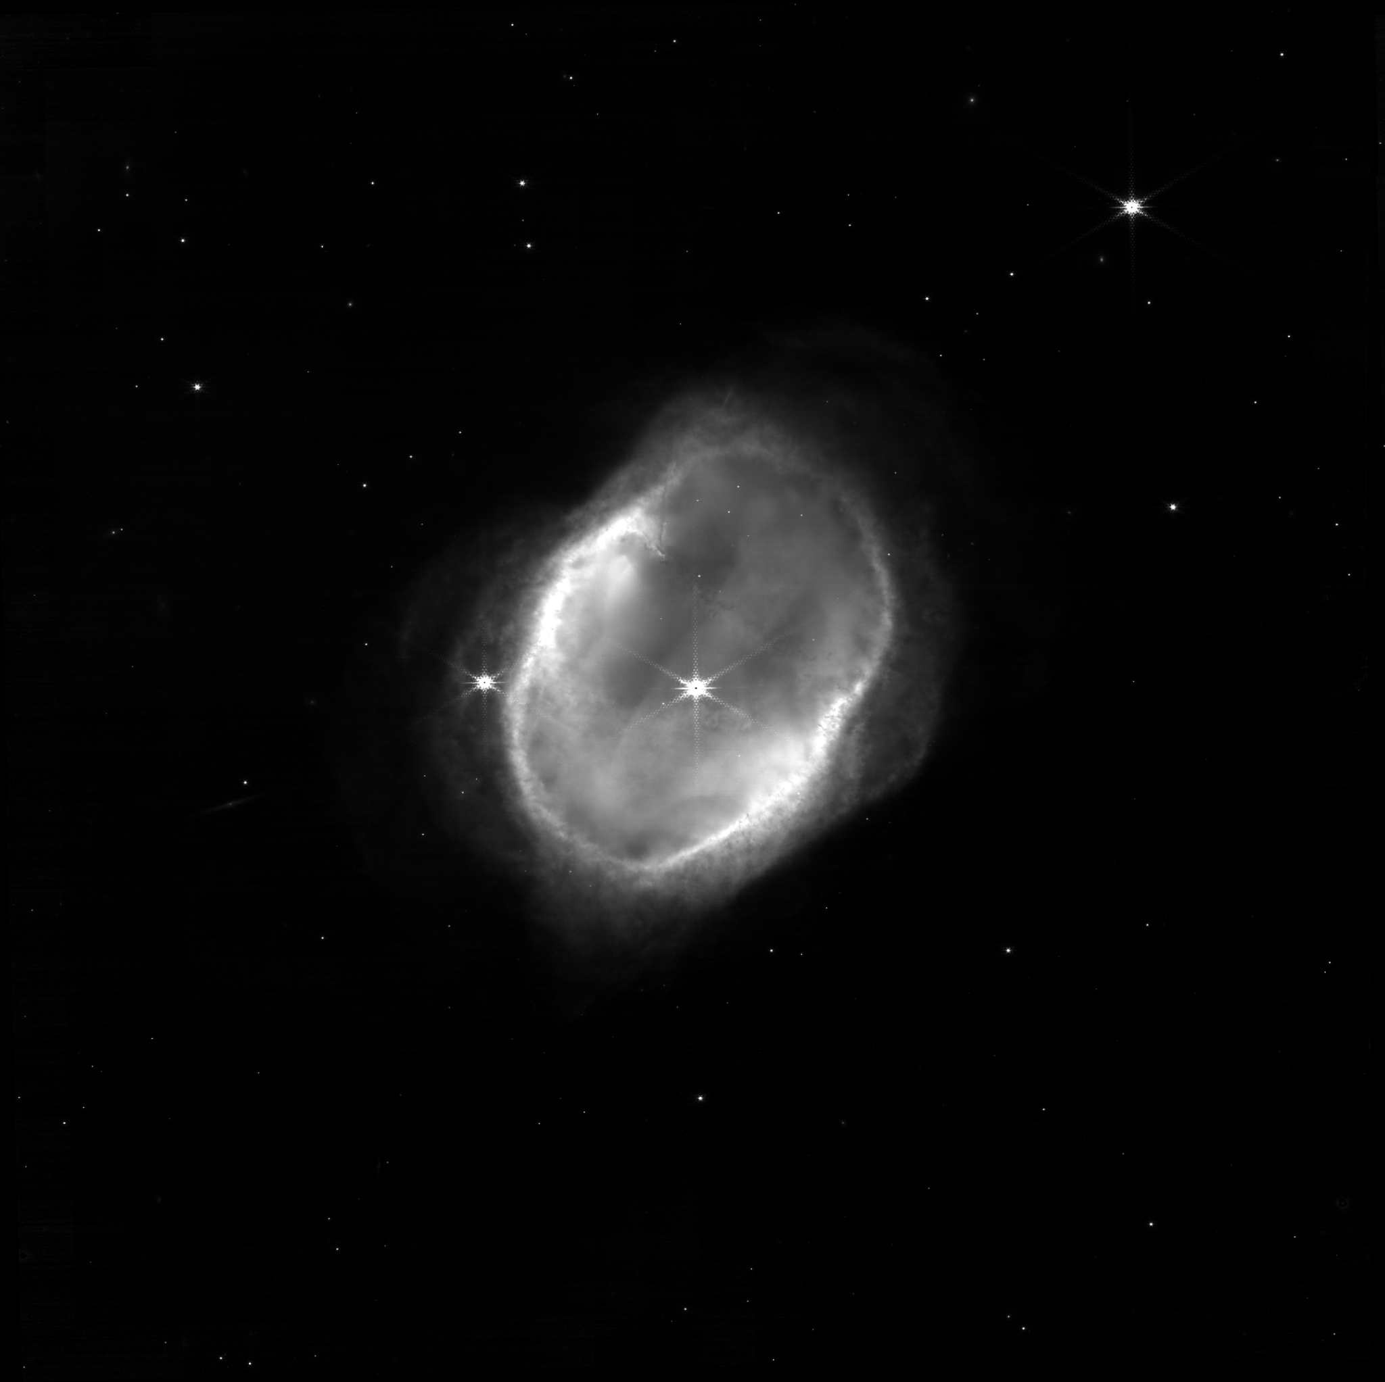
Filter: F187N, clear

Slide 15
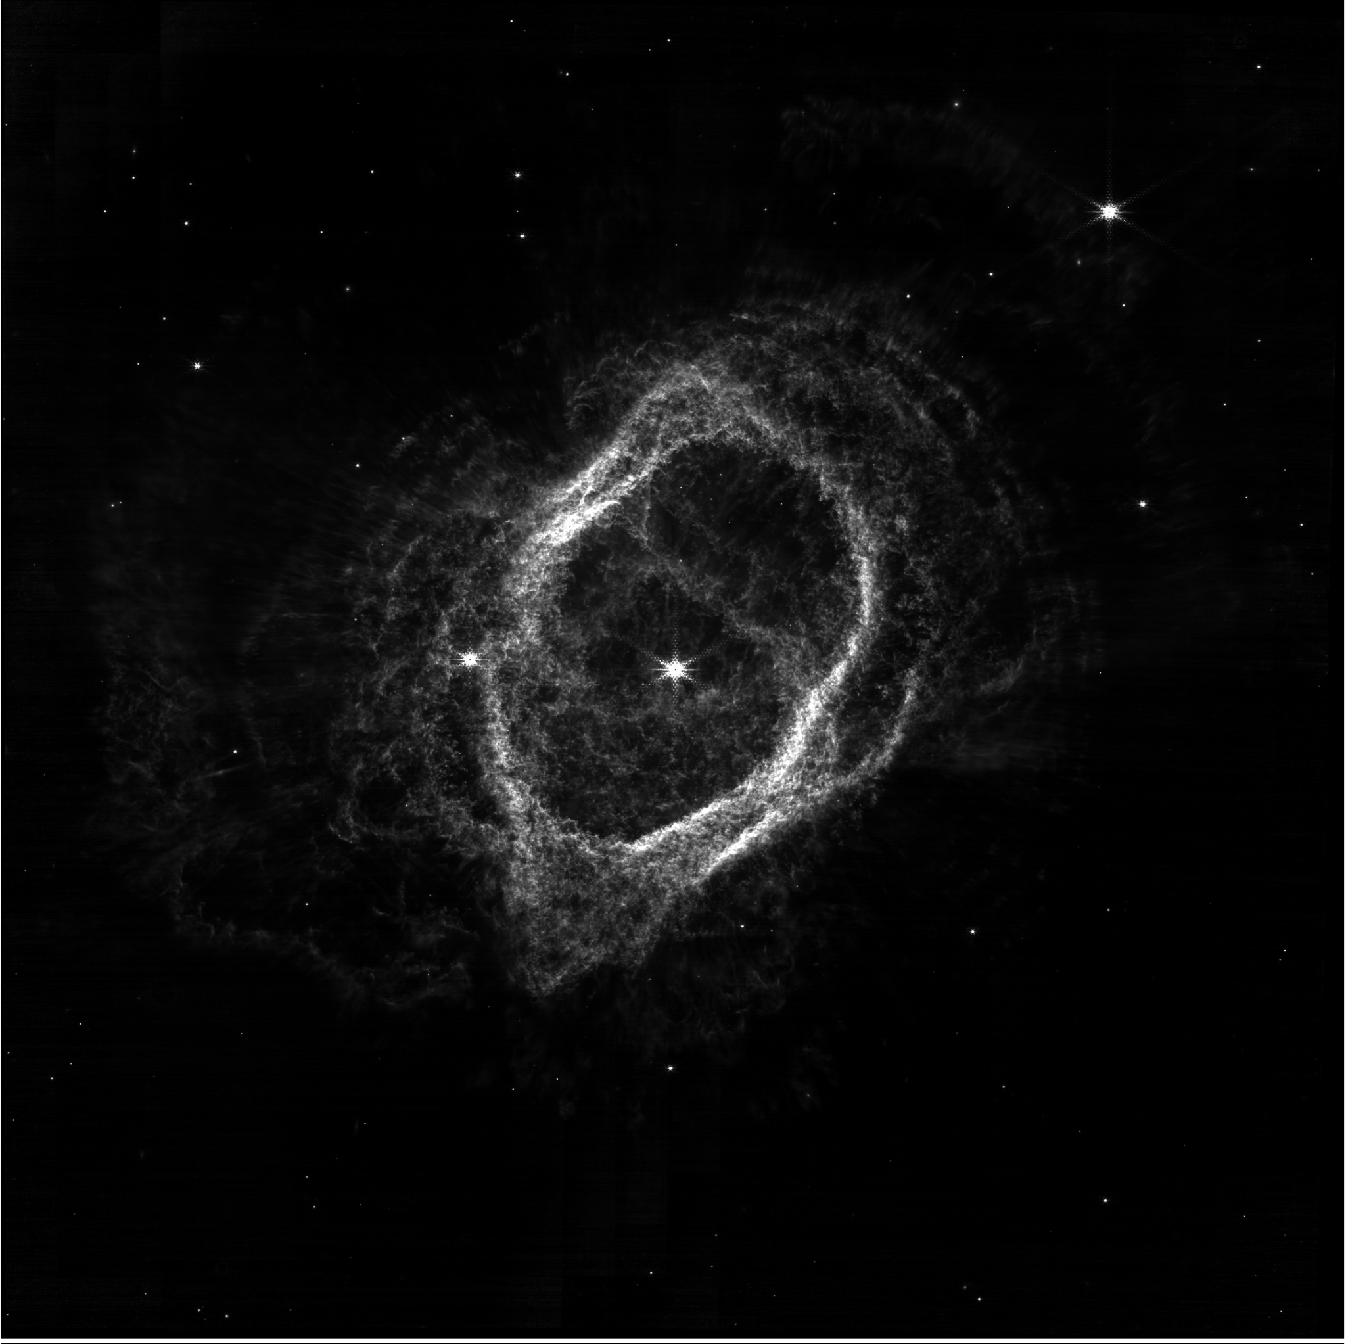
Filter: F212N, clear

Slide 16
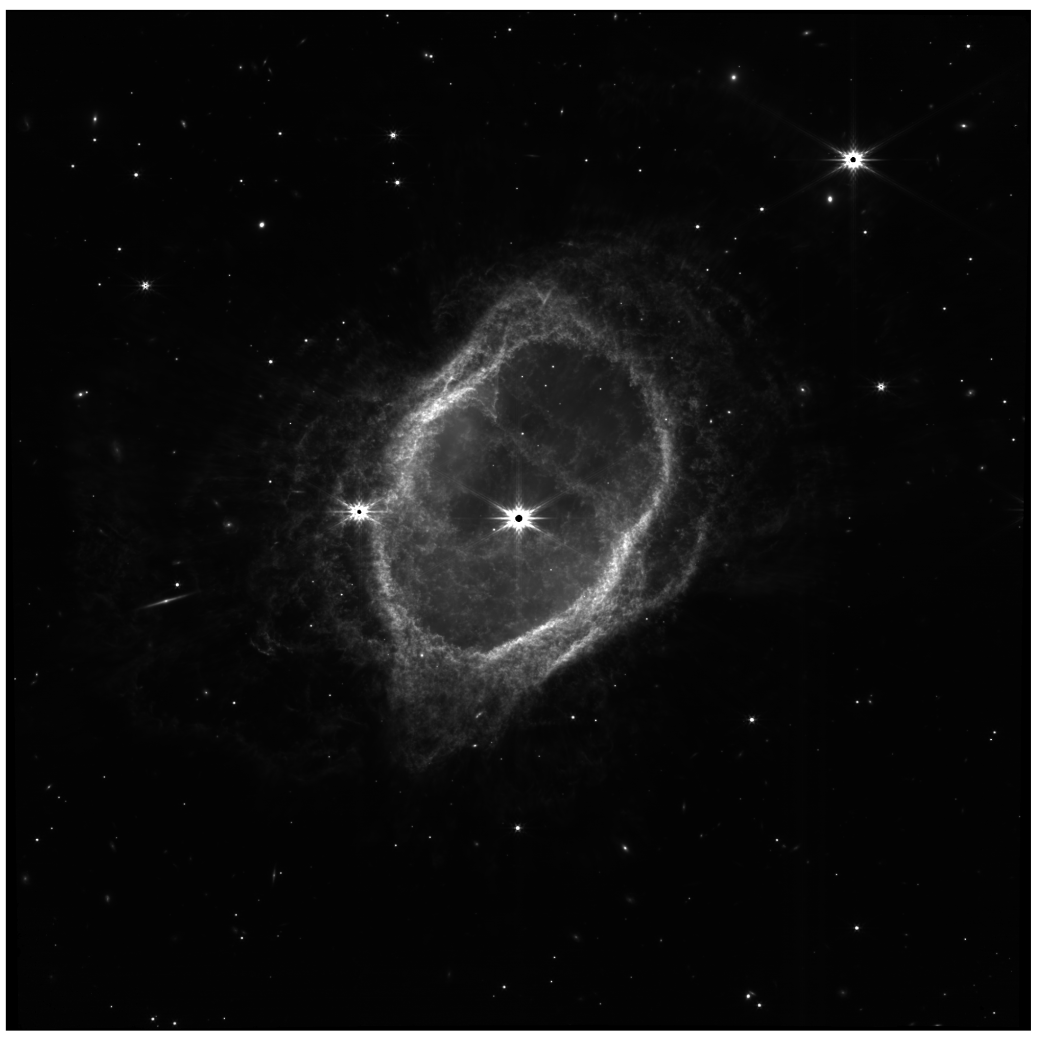
Filter: F356W, clear

Slide 17
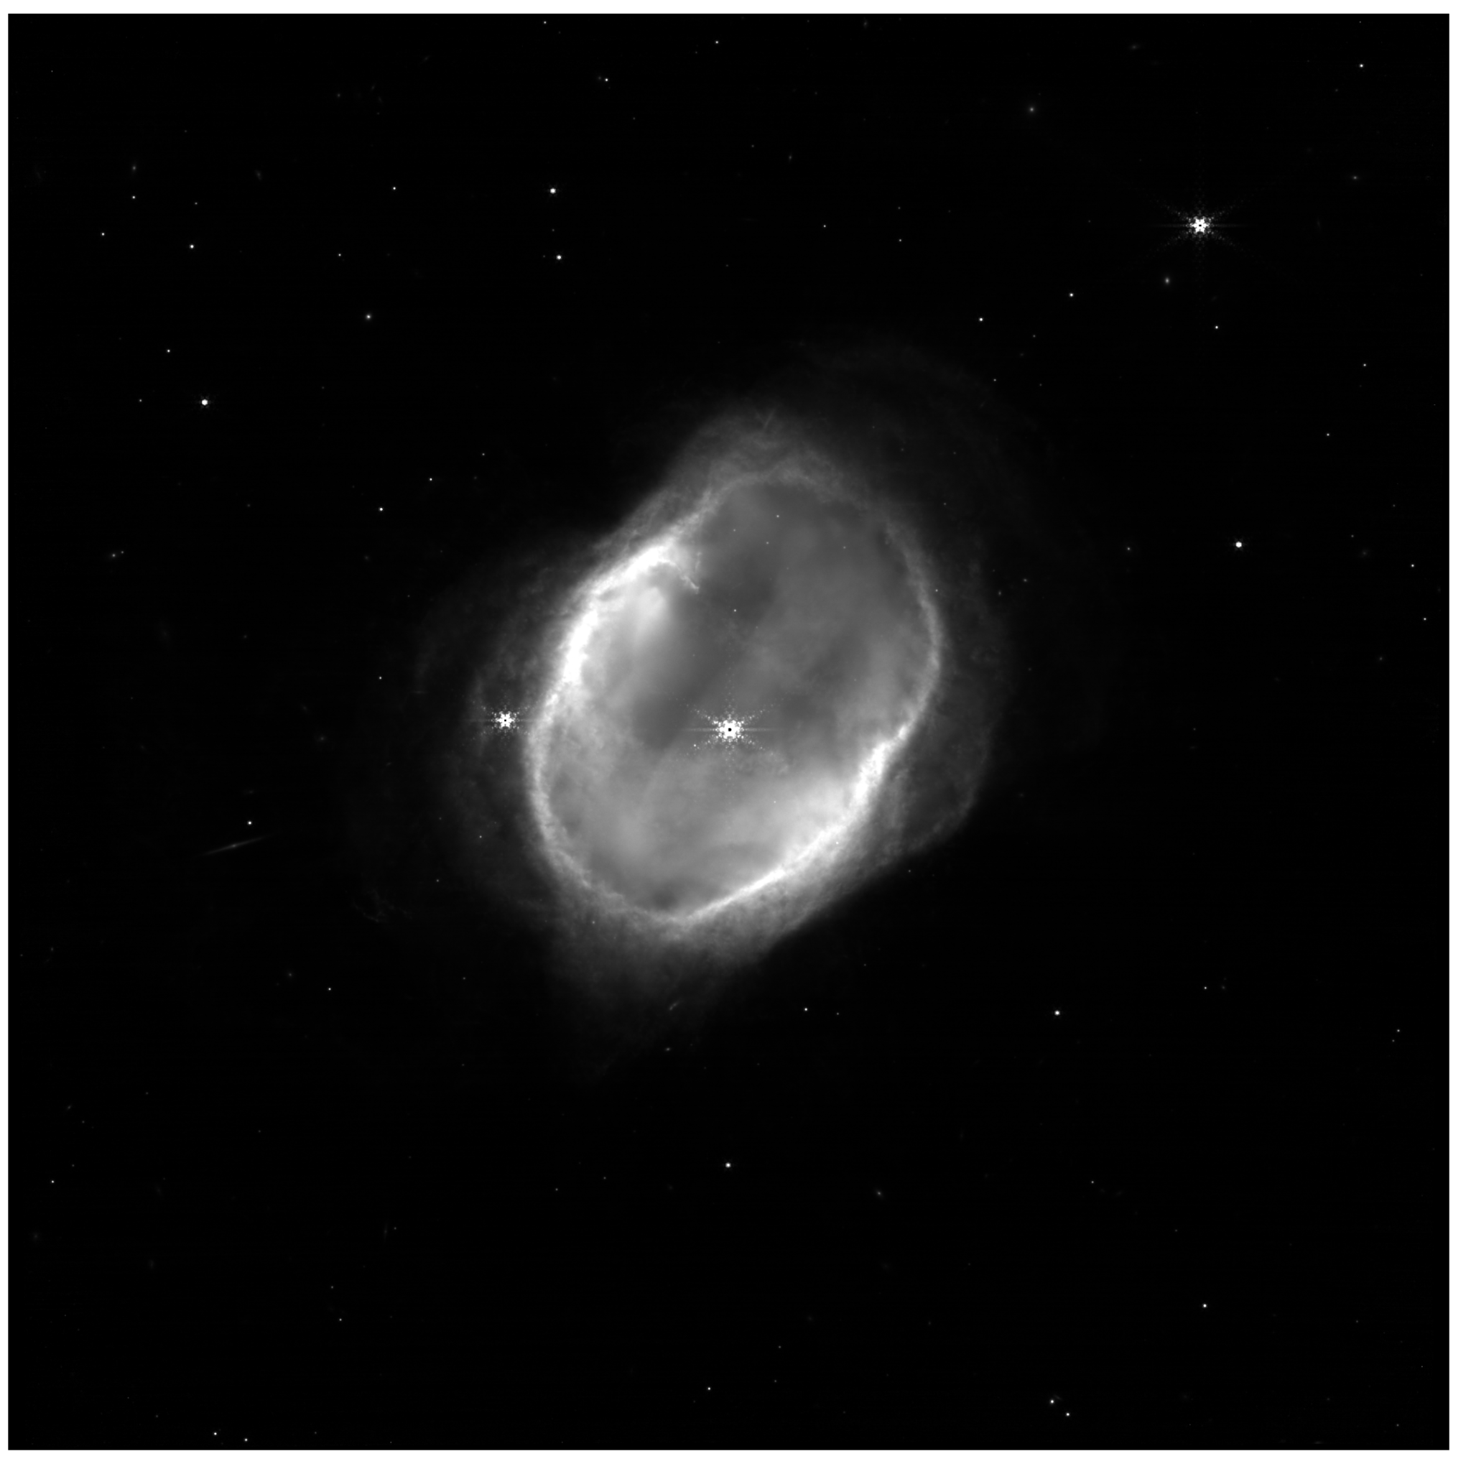
Filter: F444W, F405N pupil

Slide 18
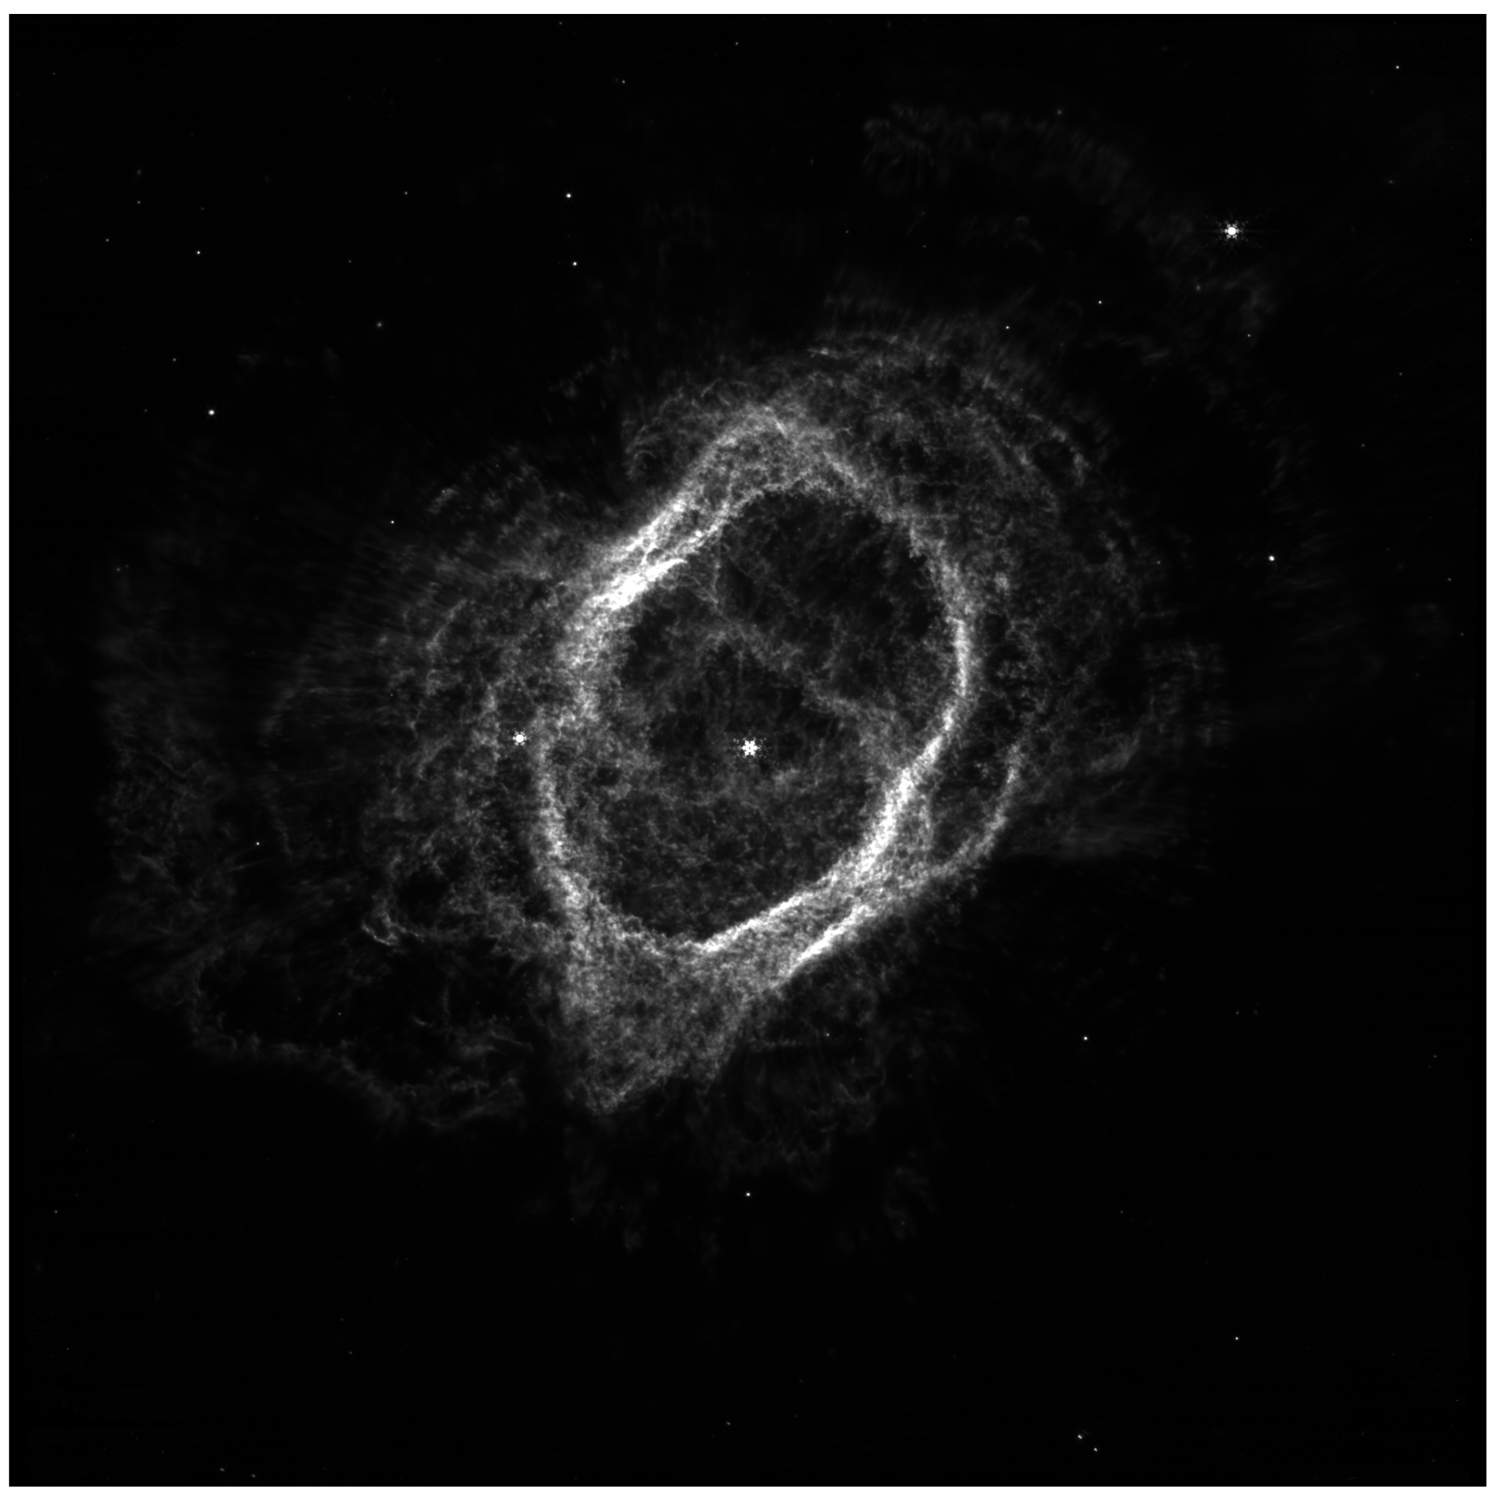
Filter: F444W, F470N pupil

Slide 19
Processing the Data: Alignment
Astroalign way:
Choose a target image
Automatically attempt to align each image to the target image via triangulation
Result:
Perfectly aligned images
Alignment on some images may fail, only option is to scrap failing images

Slide 20
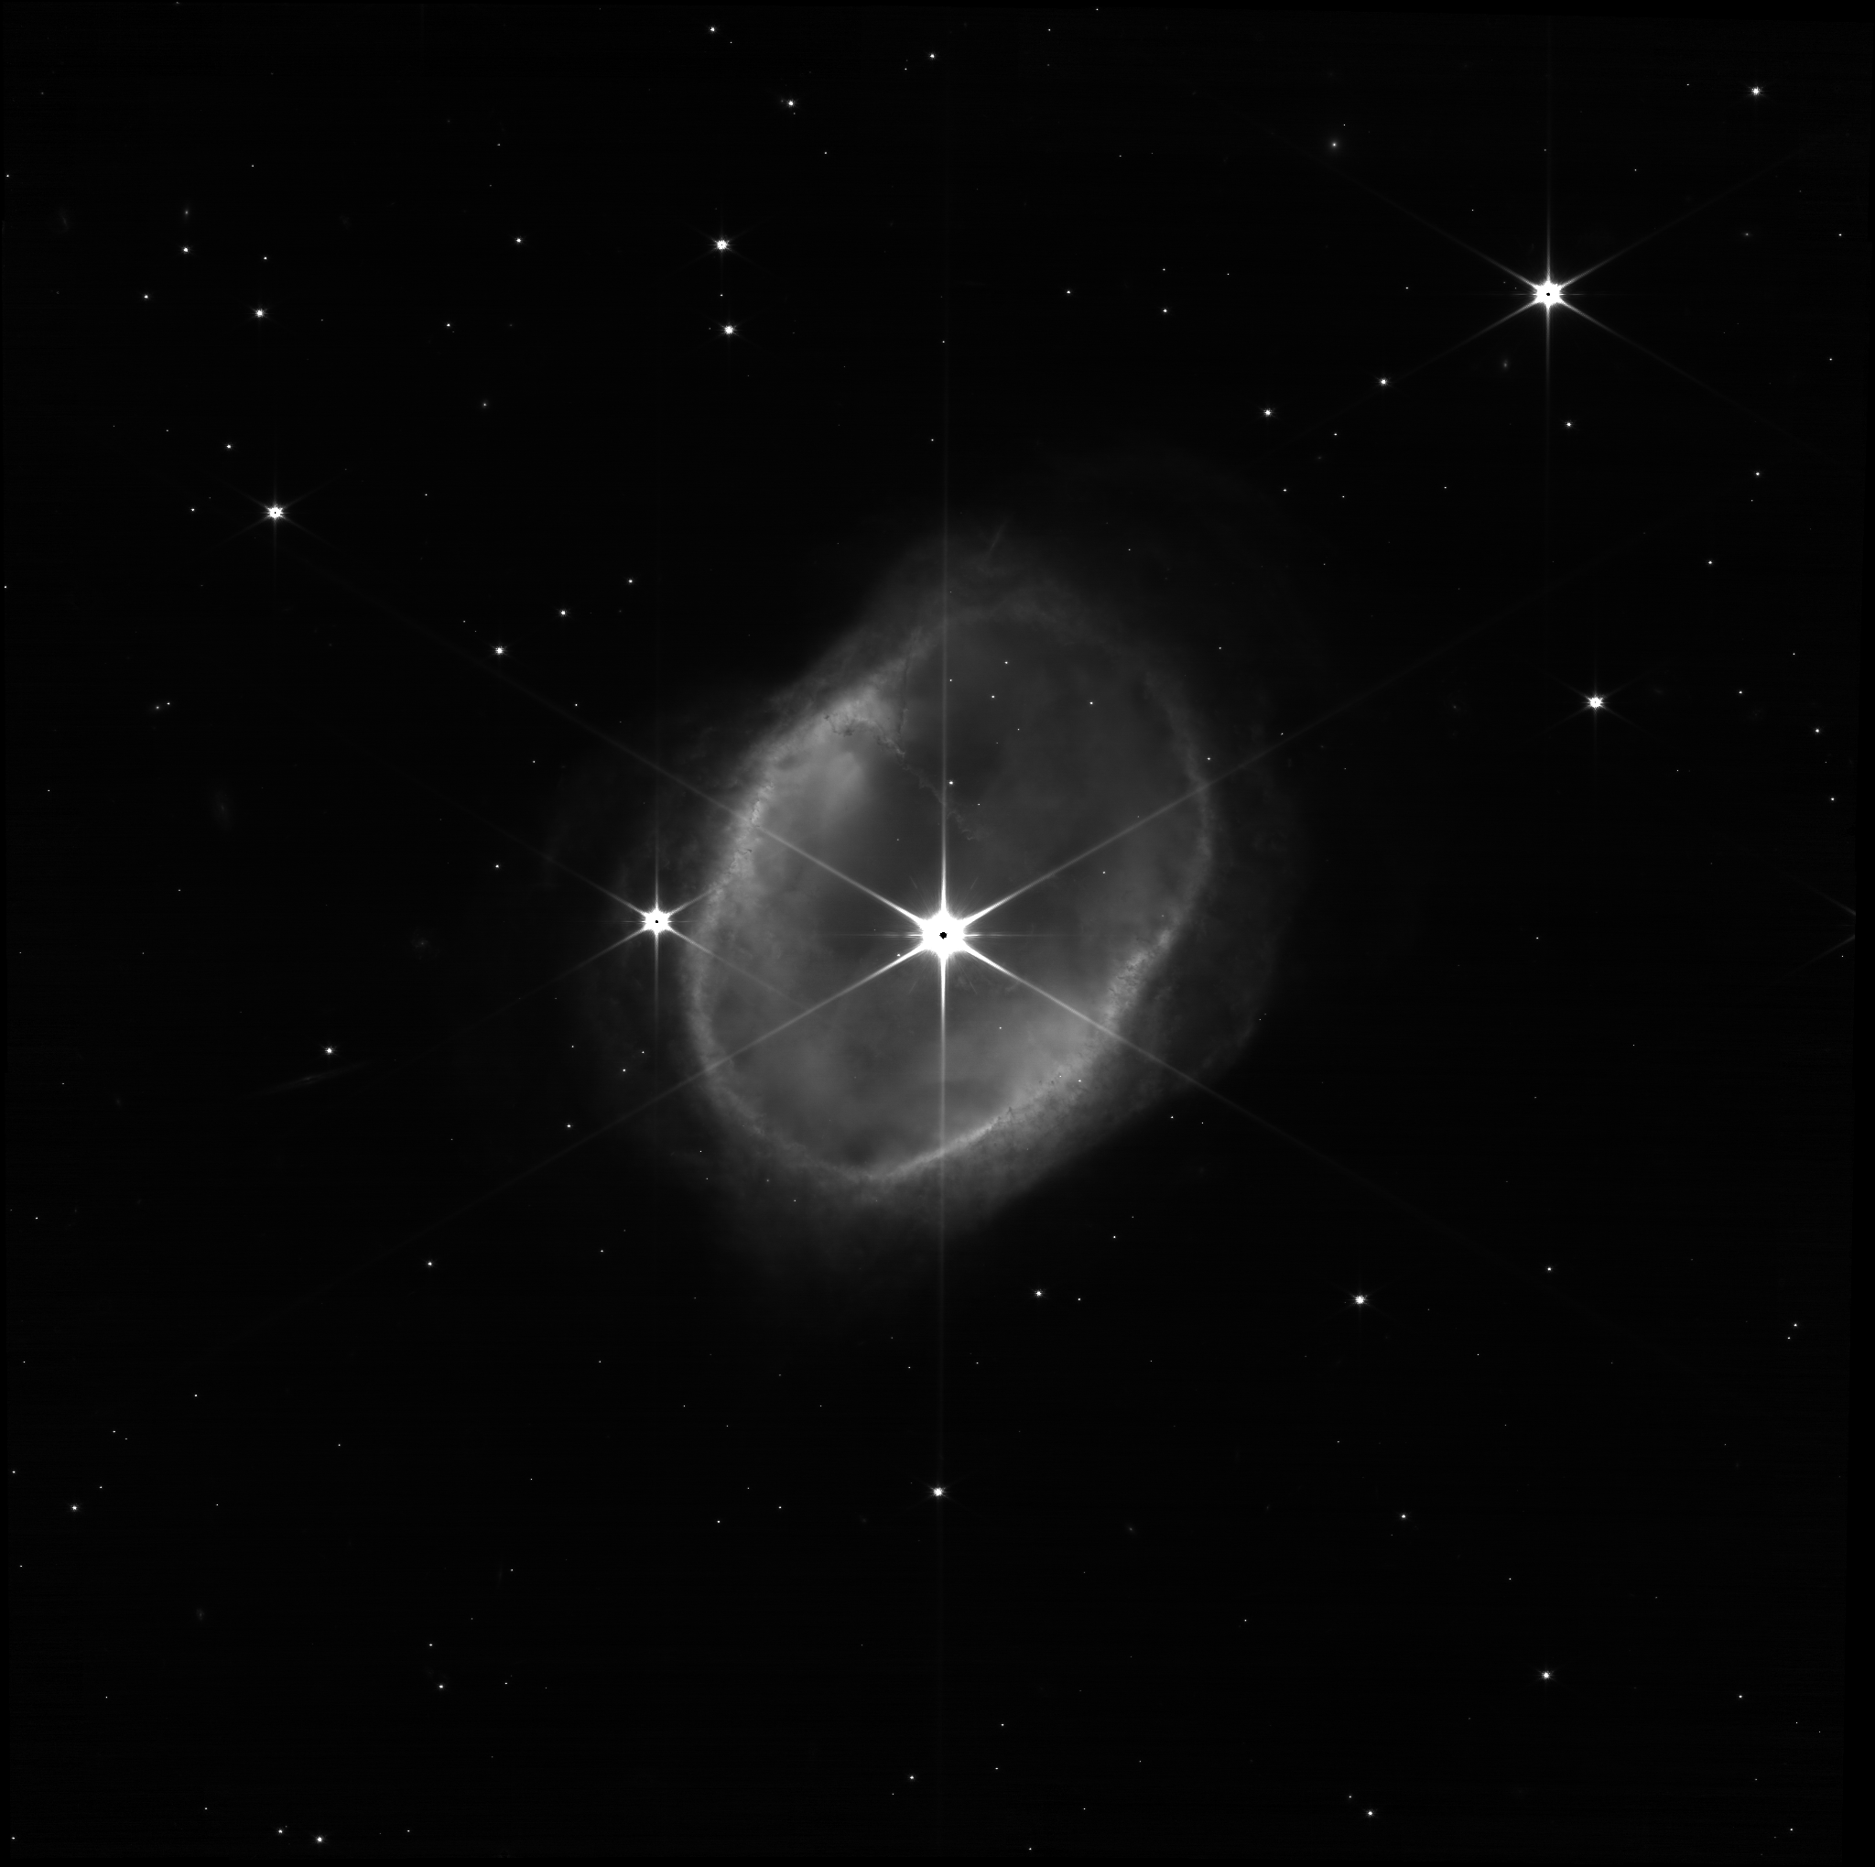

Slide 21
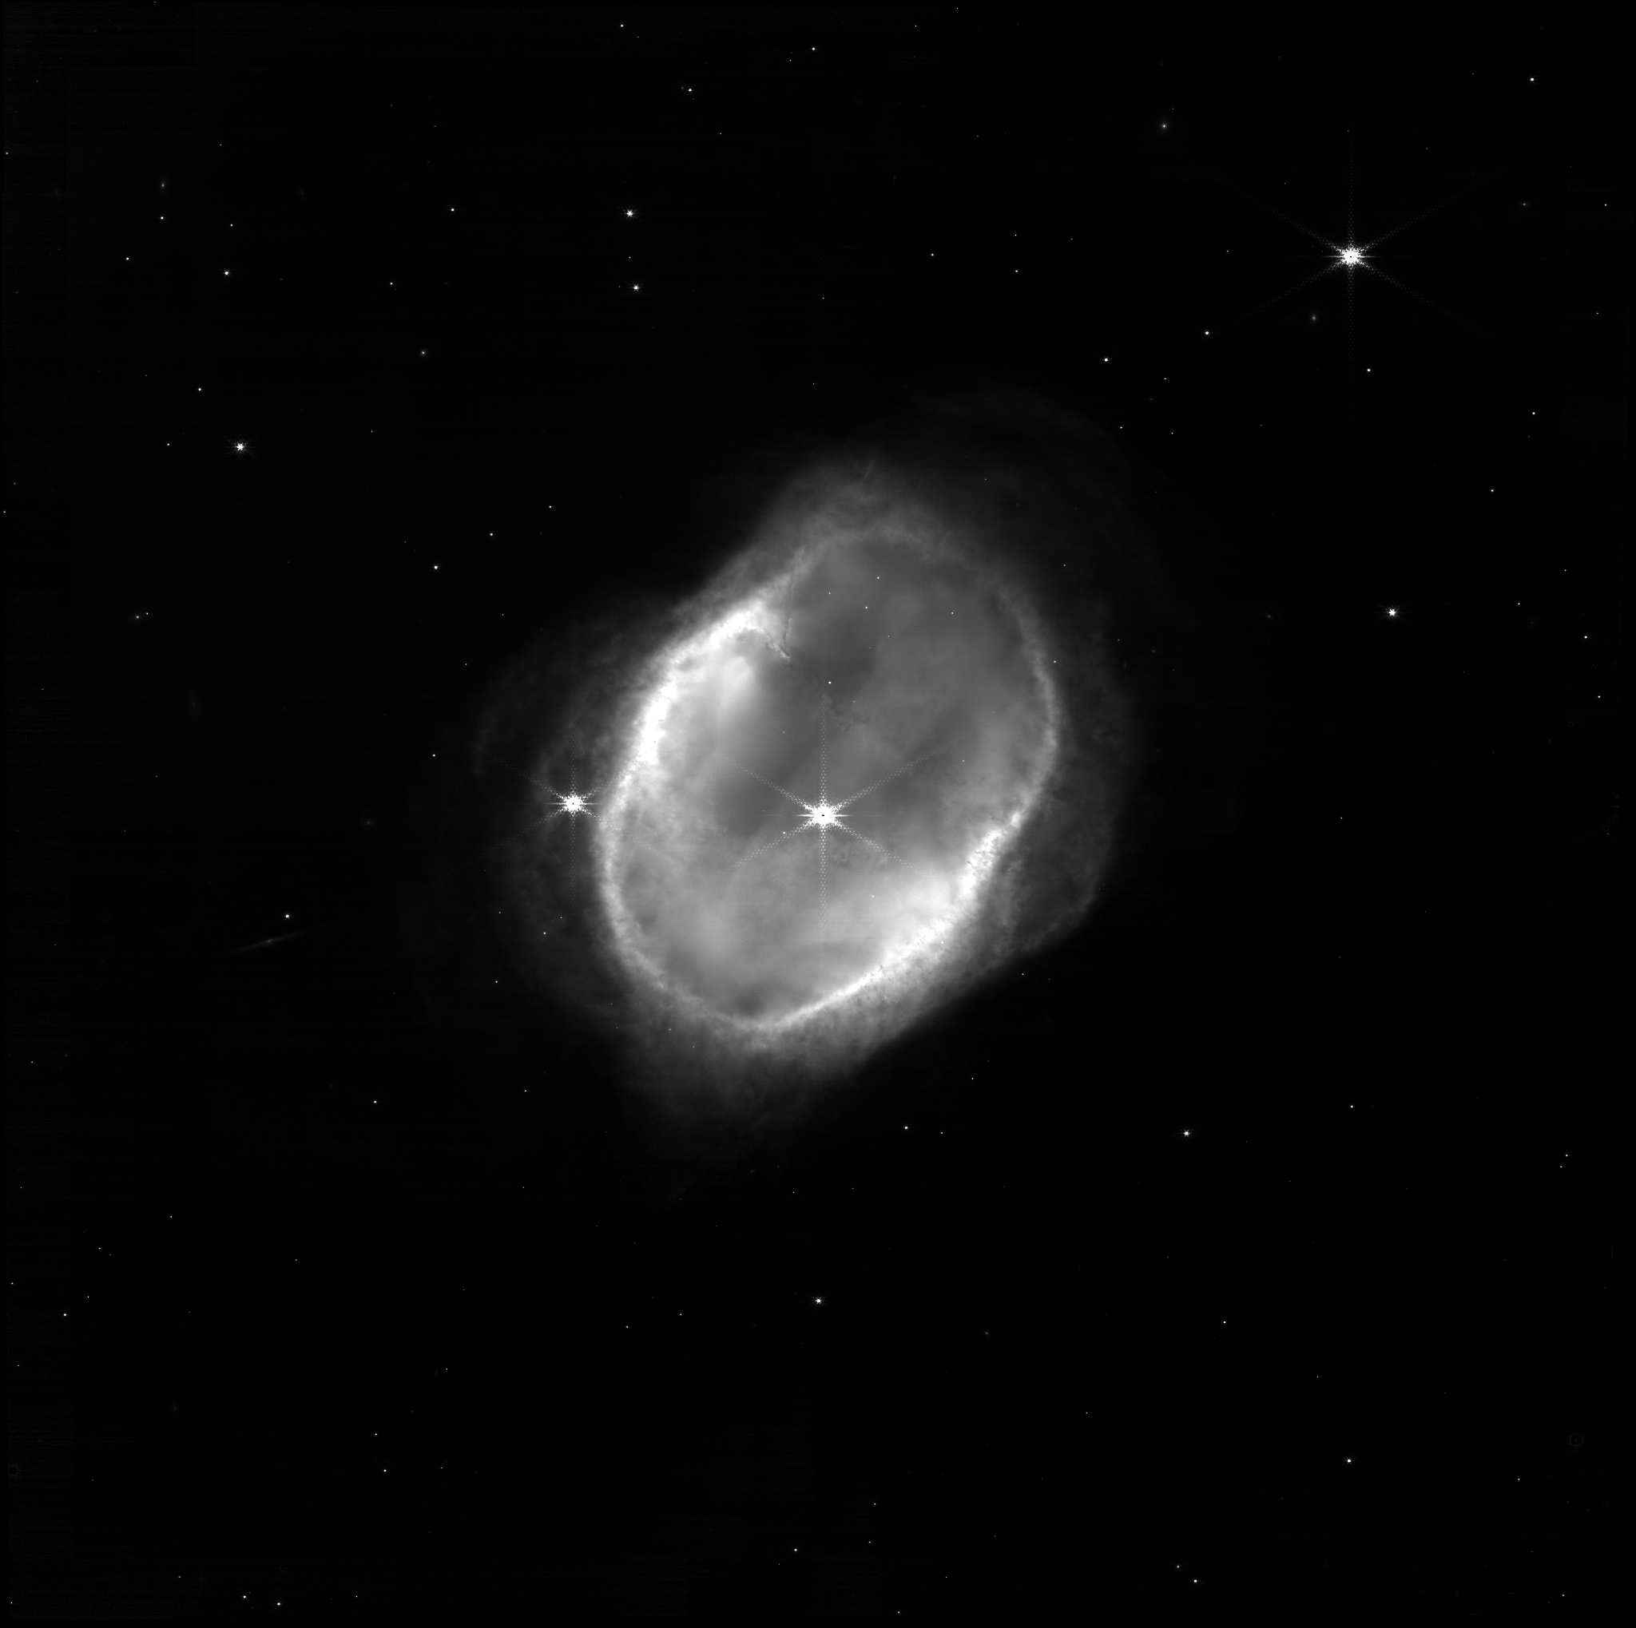

Slide 22
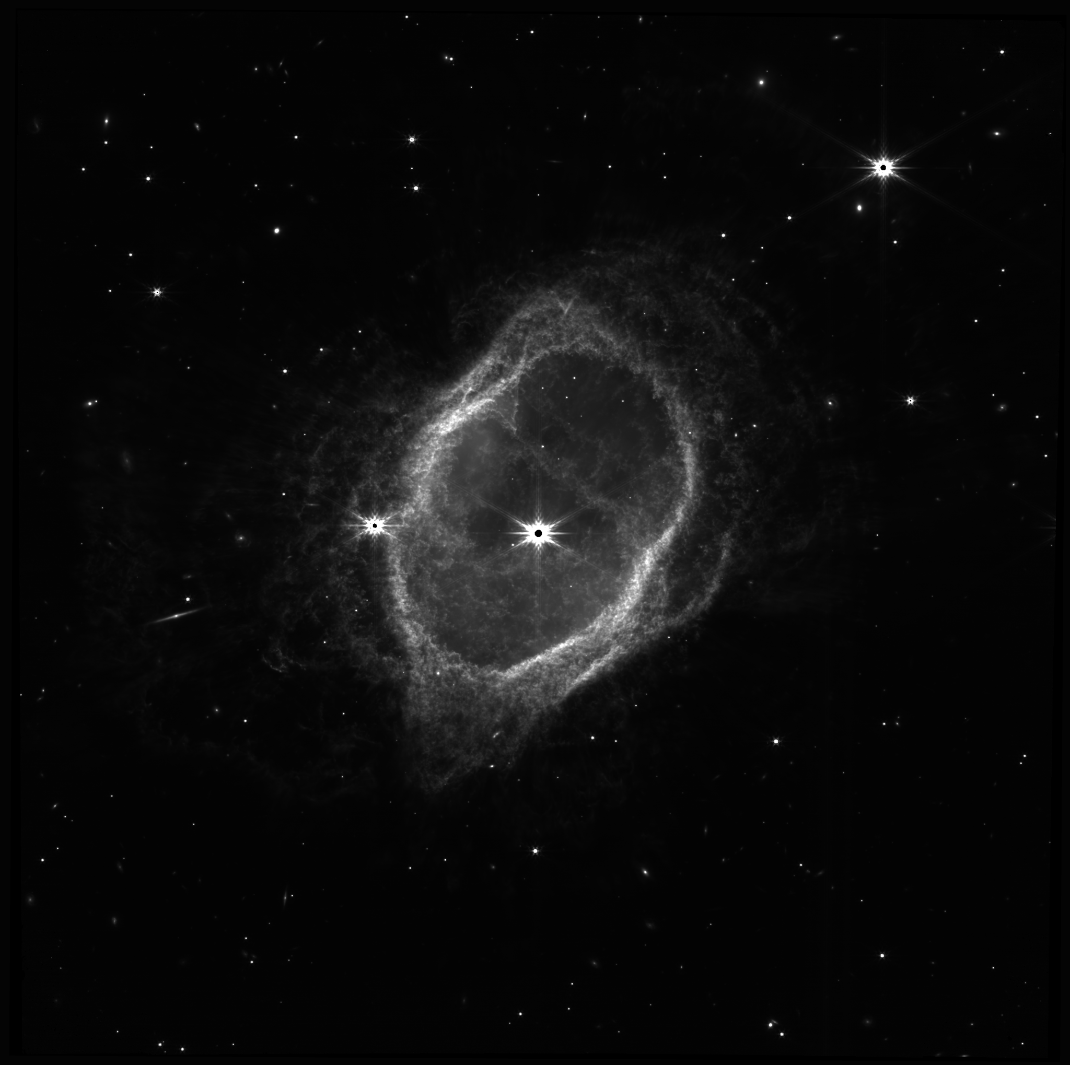

Slide 23
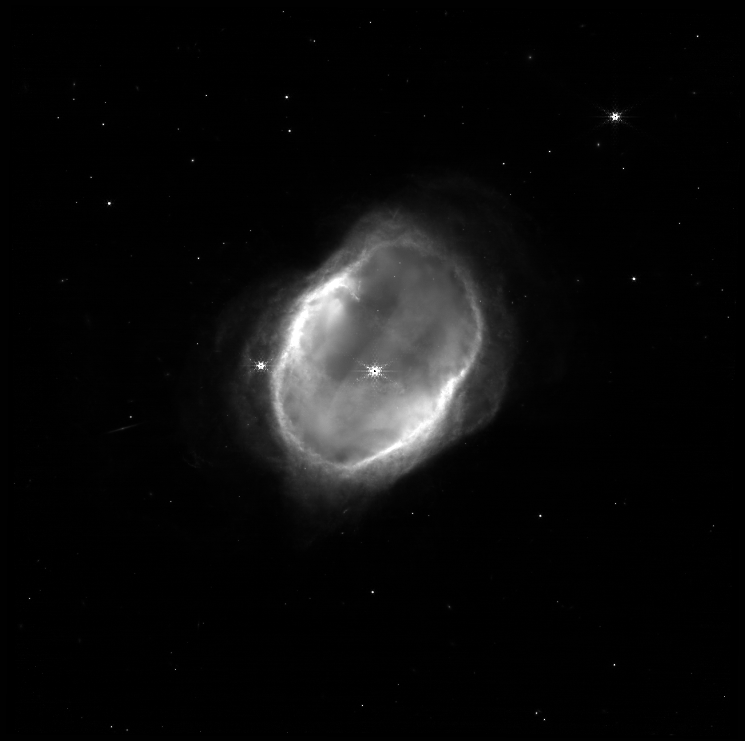

Slide 24
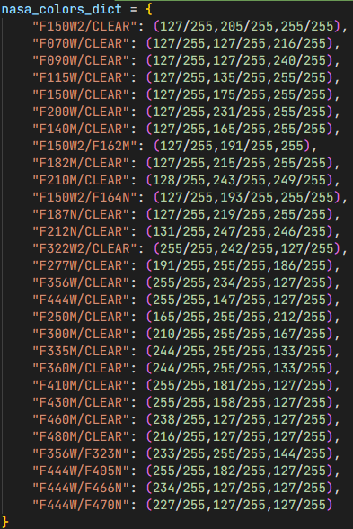
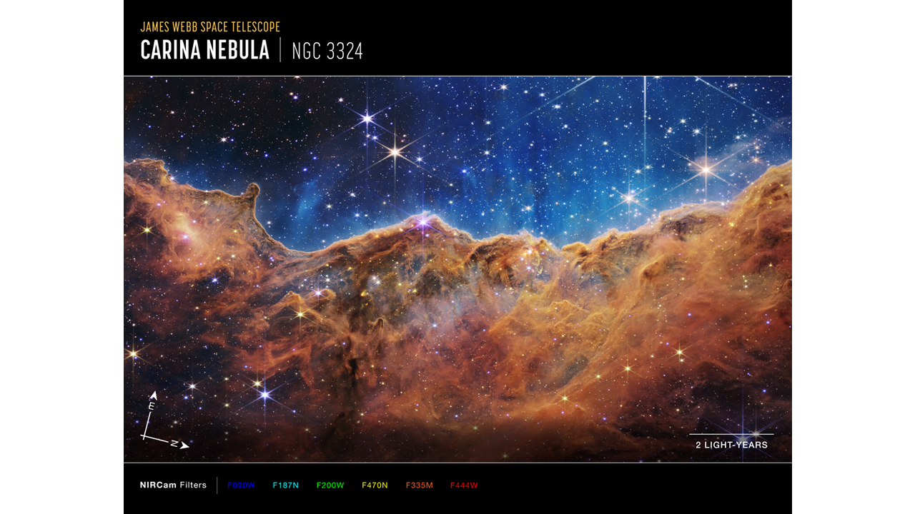
Processing the Data: Assigning Colors
Develop some set of false-color assignment
Assign a color to each image
Use NIRCam filter chart as reference
JWST team appears to use that same color reference

Slide 25
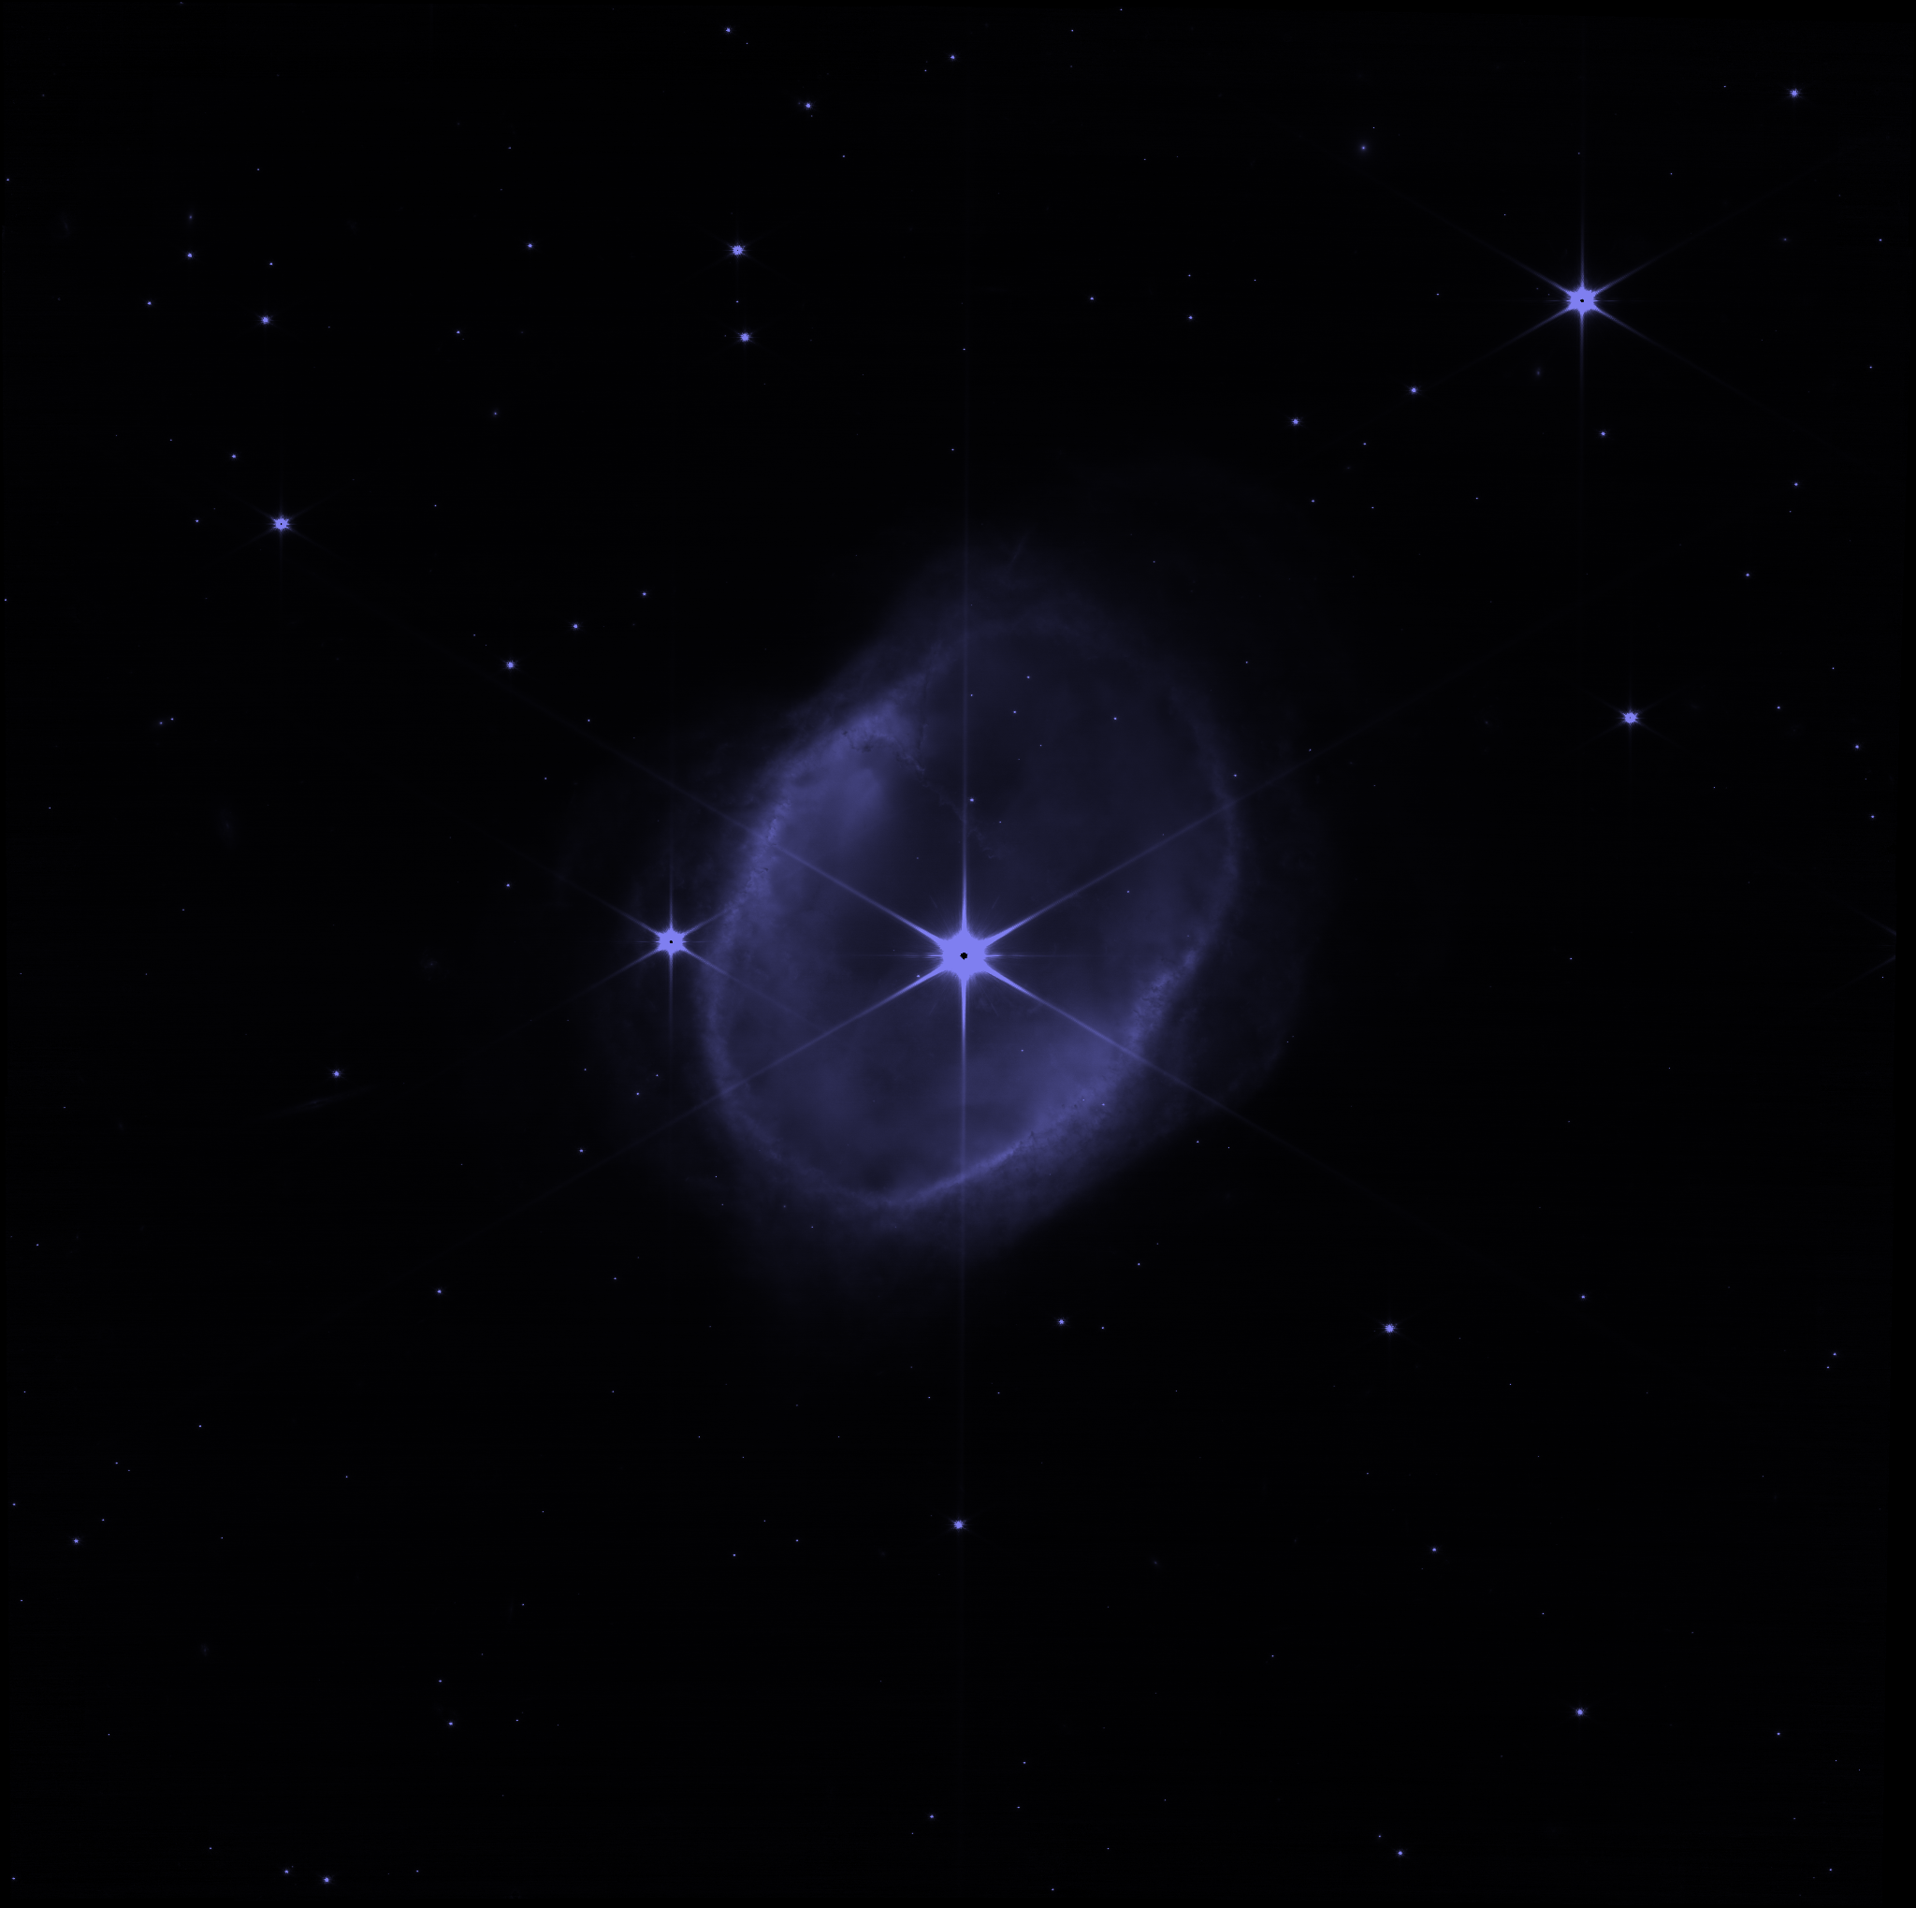

Slide 26
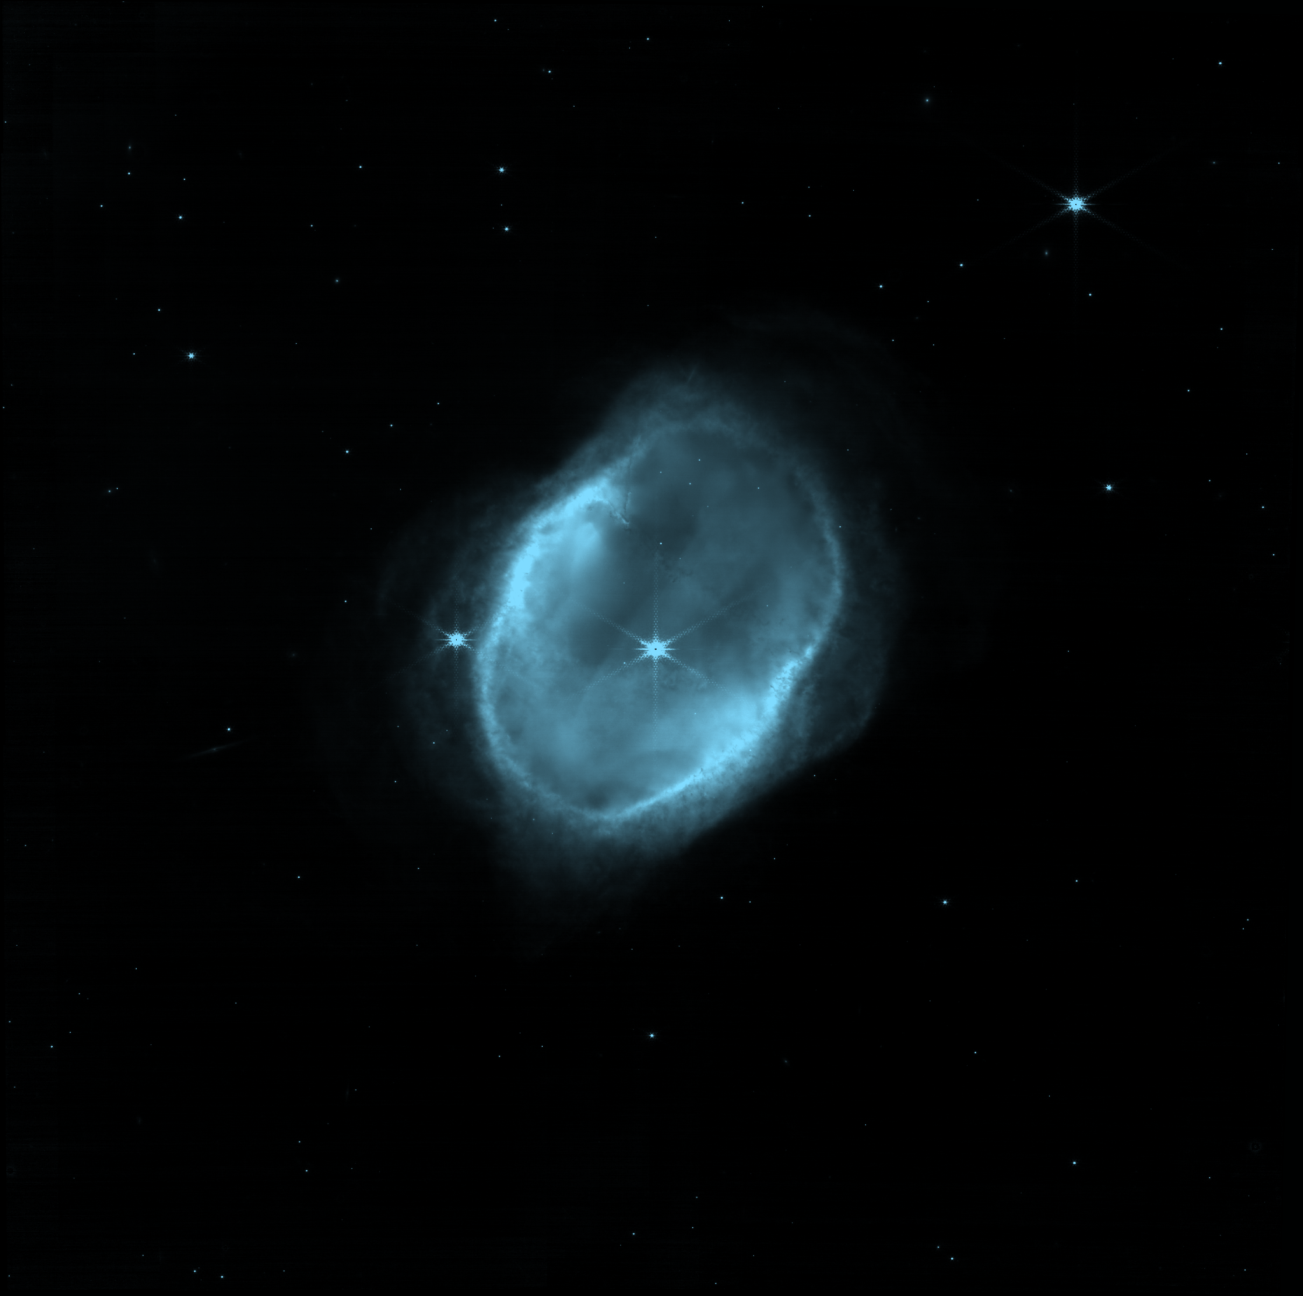

Slide 27
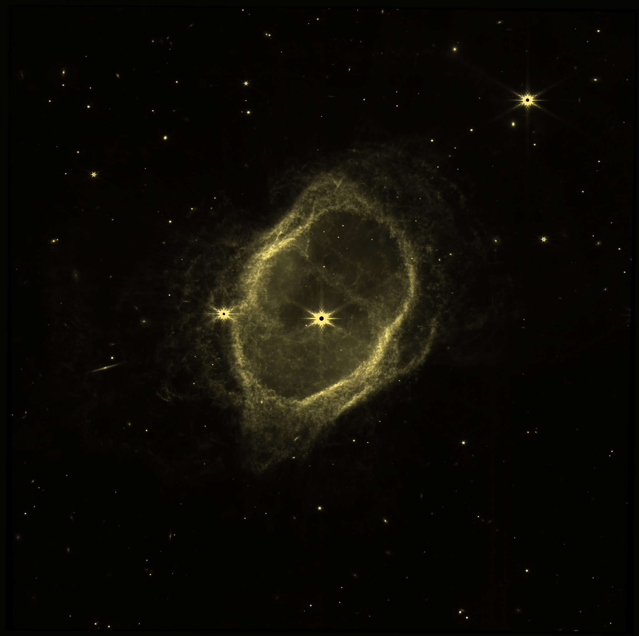

Slide 28
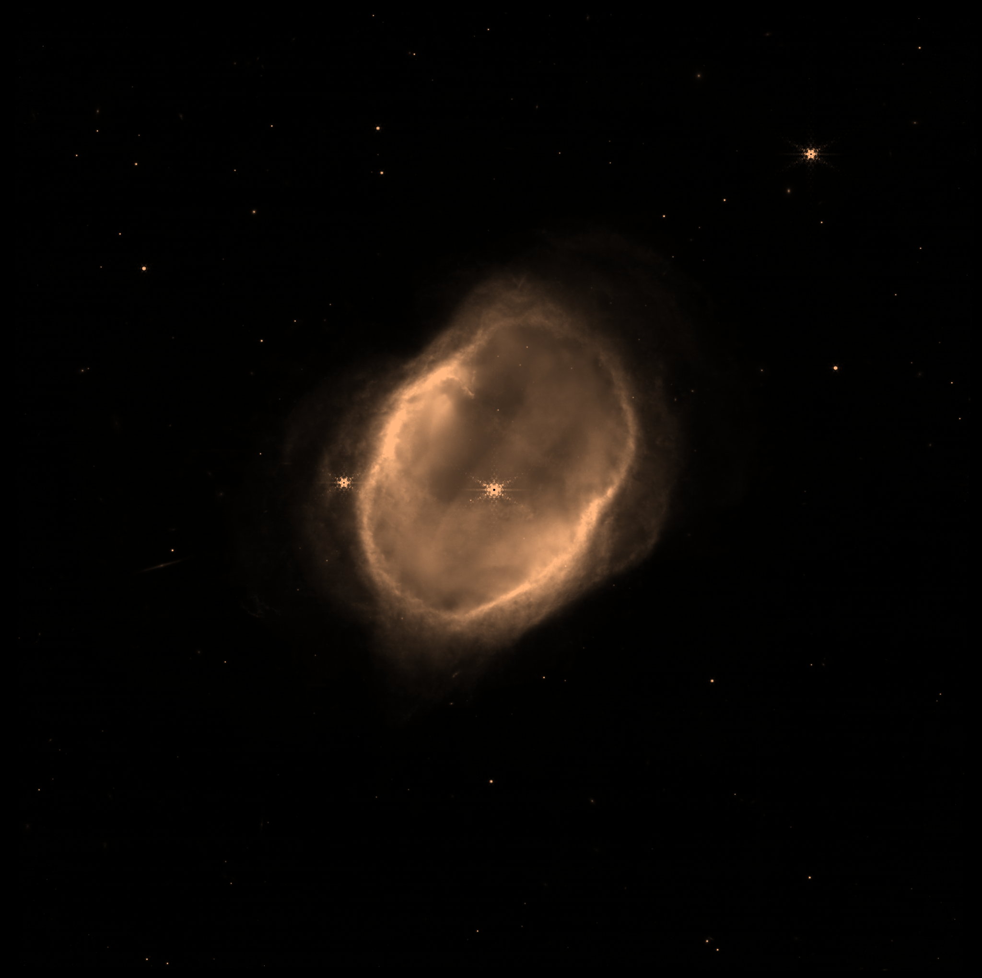

Slide 29



Processing the Data: Combining Images
Merge each layer with a lighten operation
For each RGB color channel and for each assigned color filter
result = max(nextImage * factor, thisImage)
Output as uint8 PNG

Slide 30
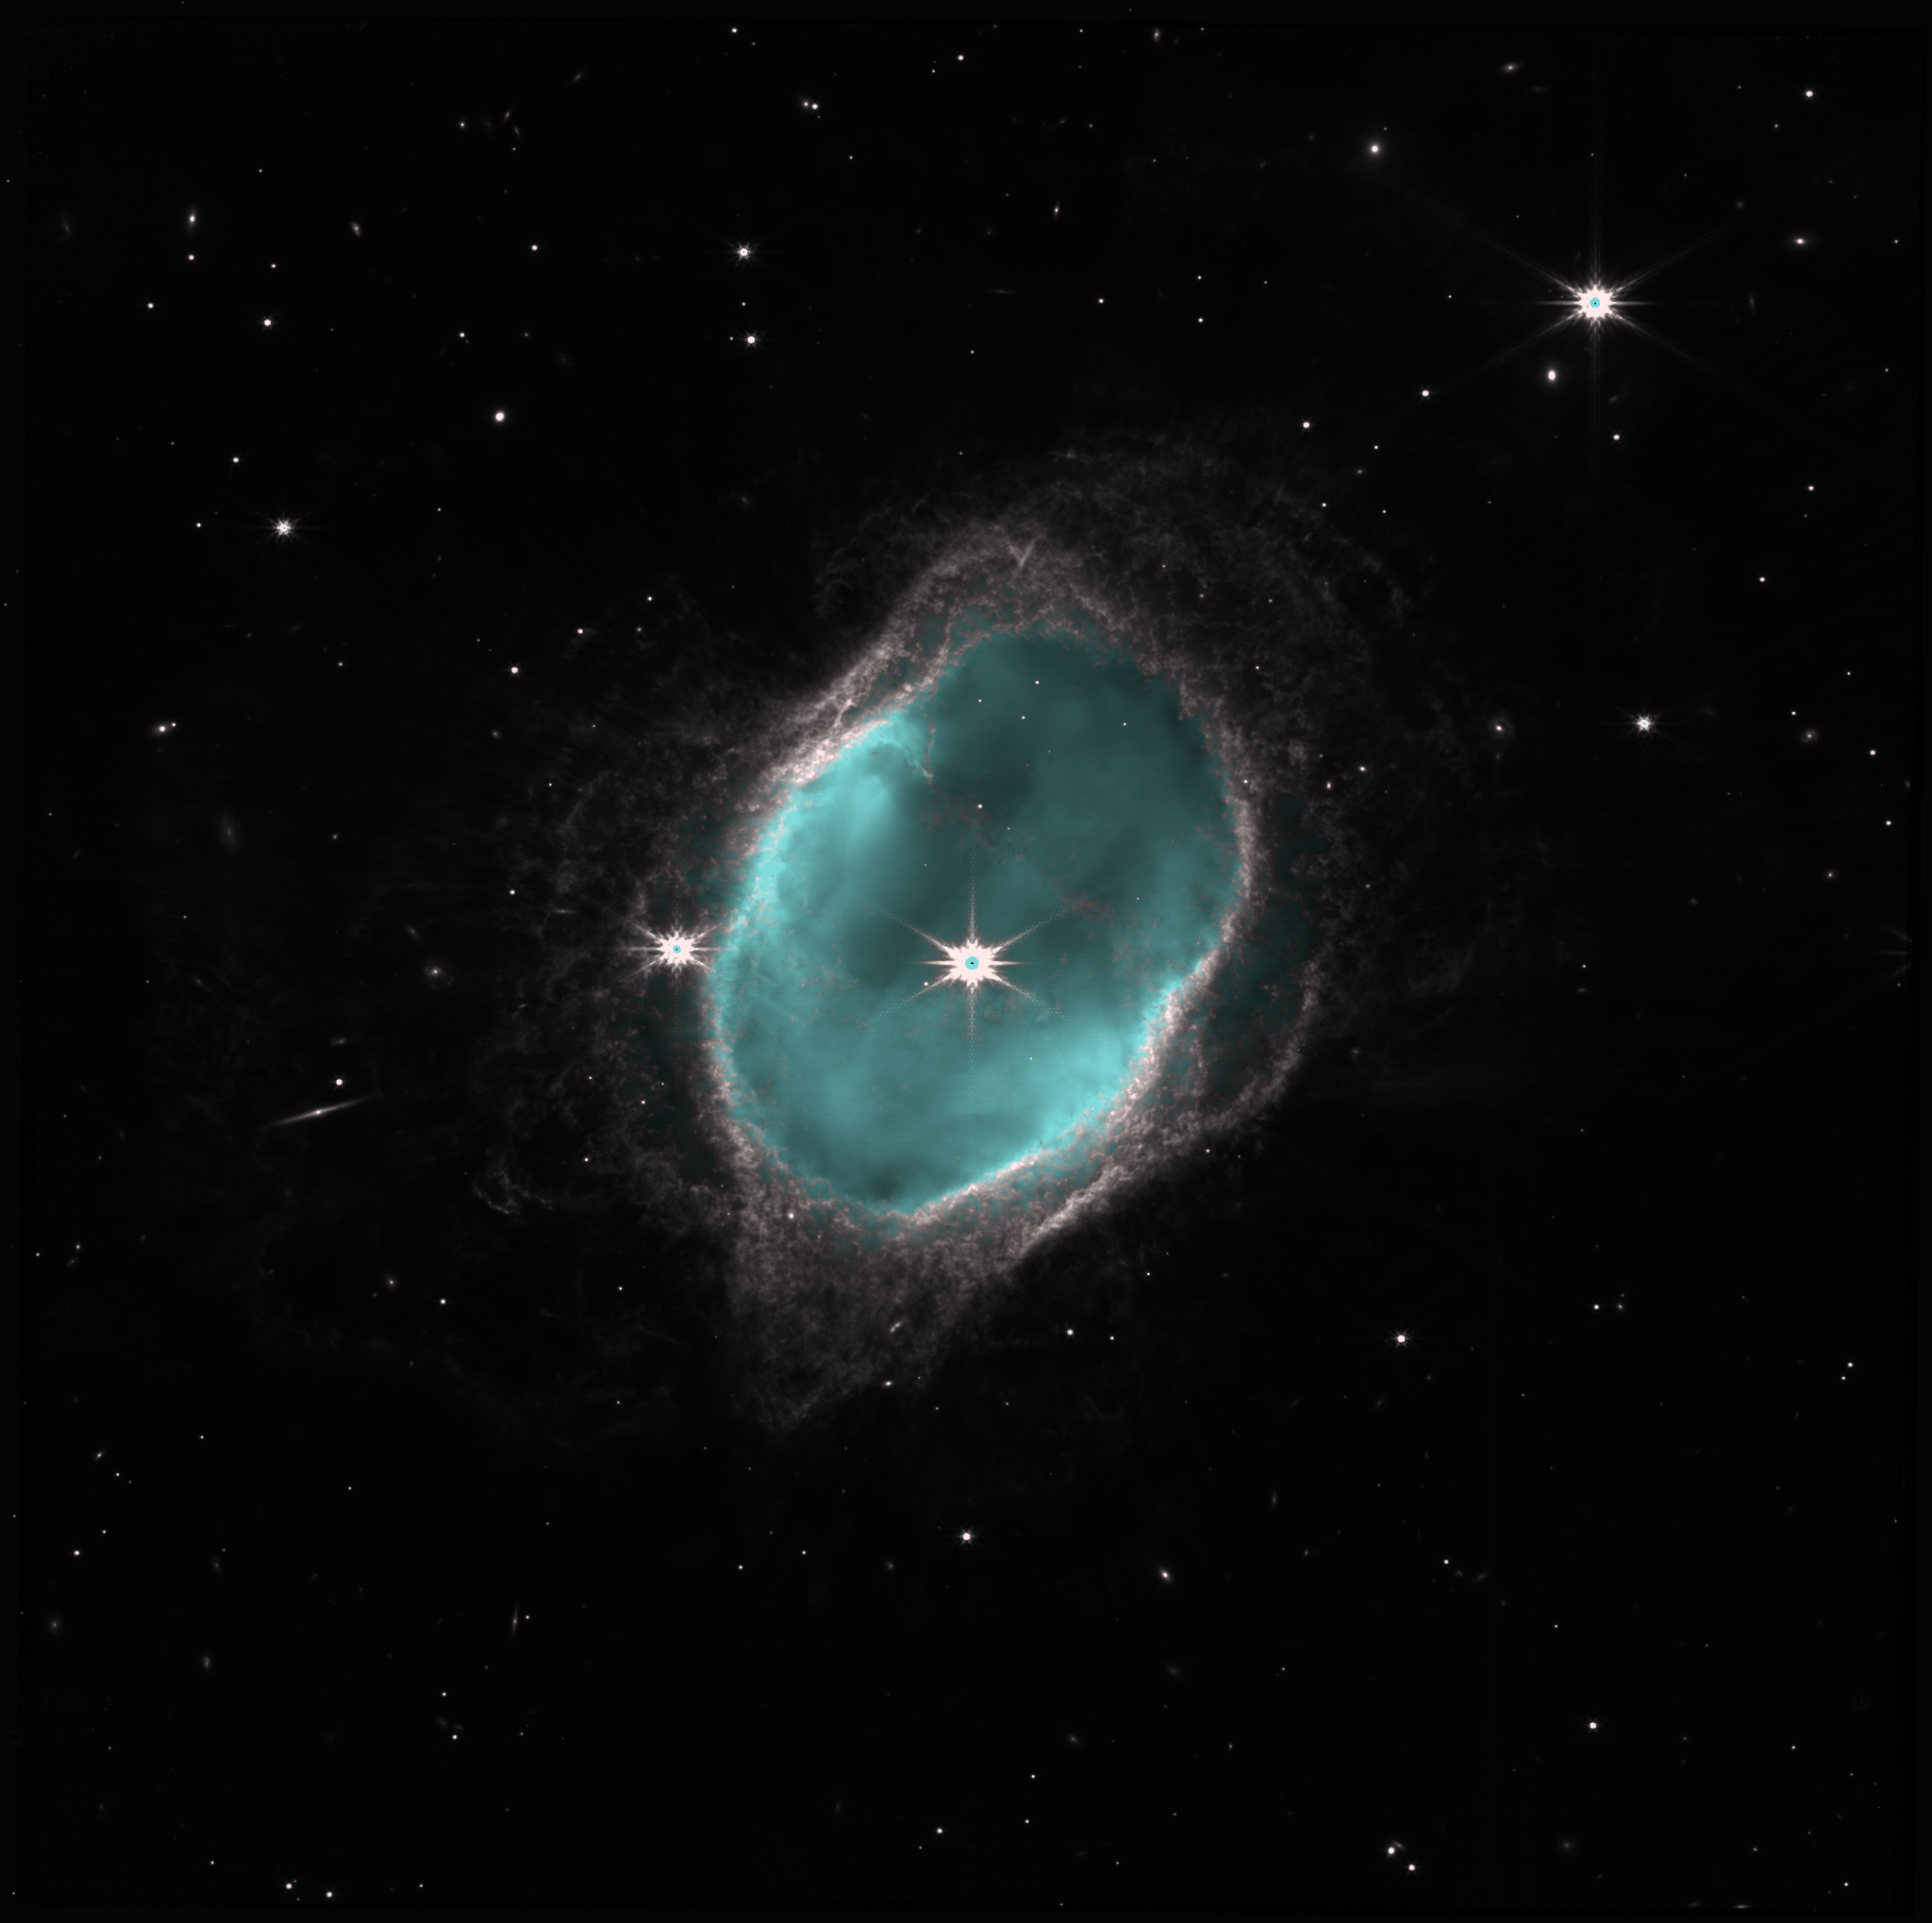
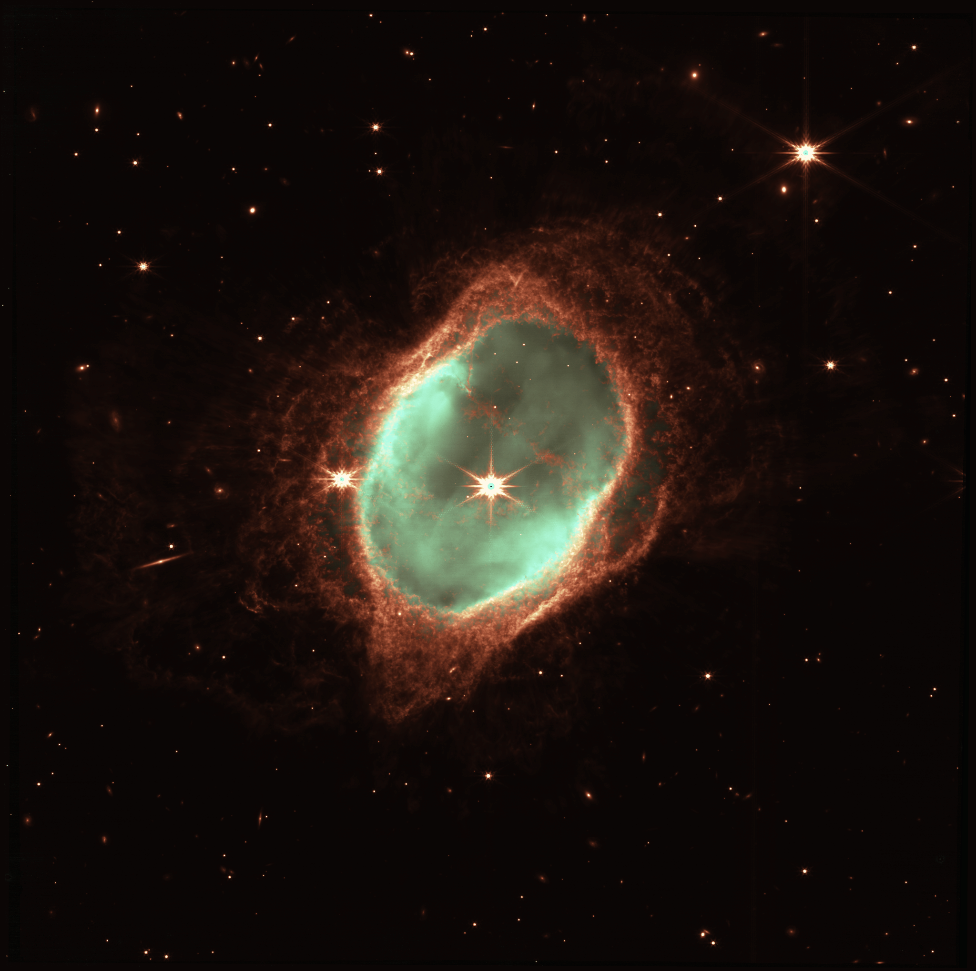
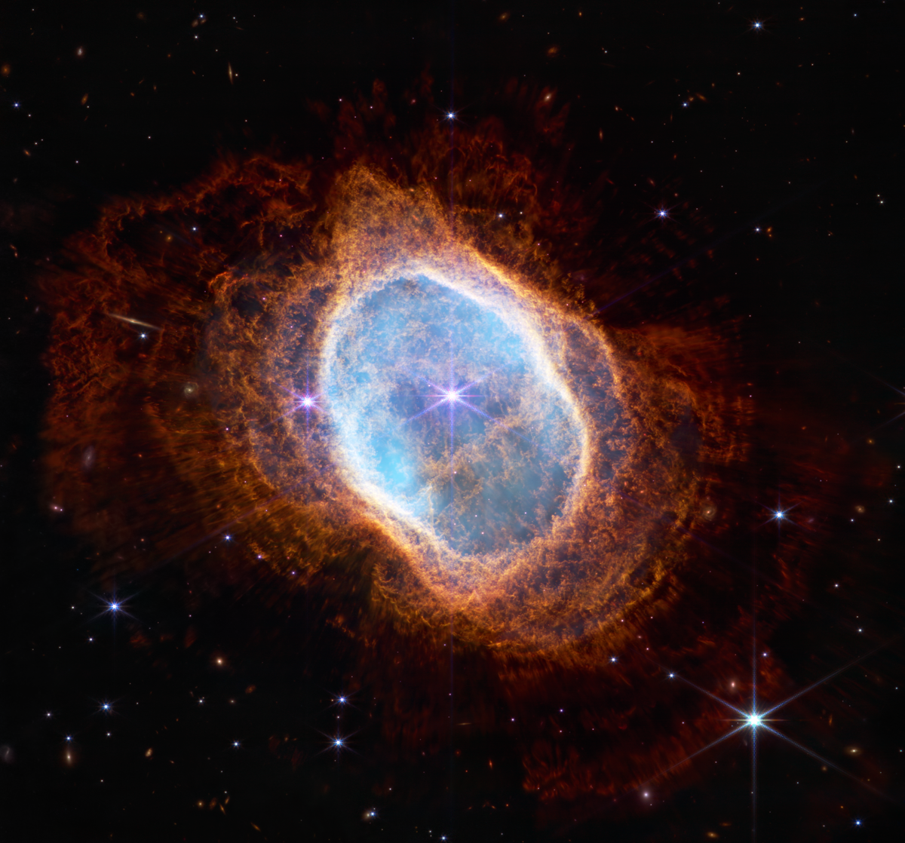
Processing the Data: Displaying the Images
Output of my script with NASA’s color assignment (using Astroalign alignment)
PLUS quick color curve enhancement in photo editor
Output of my script with NASA’s color assignment (using Astroalign alignment)
What NASA released

Slide 31
Conclusions
Using a script to successfully download and (eventually) align the images would be helpful
My solution makes it very easy to download mission data to organized directories
Once this script can automatically align all images, it will be helpful
Programatically coloring the final image is limited
Ultimately up to the editor to determine what looks aesthetically pleasing
Publicly released images go through a team of artists to combine and enhance the images
Color choice might depend on scene

Slide 32
Future Work
Align all images using the given photo metadata
In the current version, no header data is used other than the filter
Add further color adjustments to script
Currently only perform lighten operation on each filter, then combine them
Possibility of adding color curve adjustment to add more vivid color
Fill in occluded areas
Test more target scenes
Only tested NGC 3132
This script should in theory work for other images, since no scene-specific parameters were used

Slide 33
Questions?

Slide 34
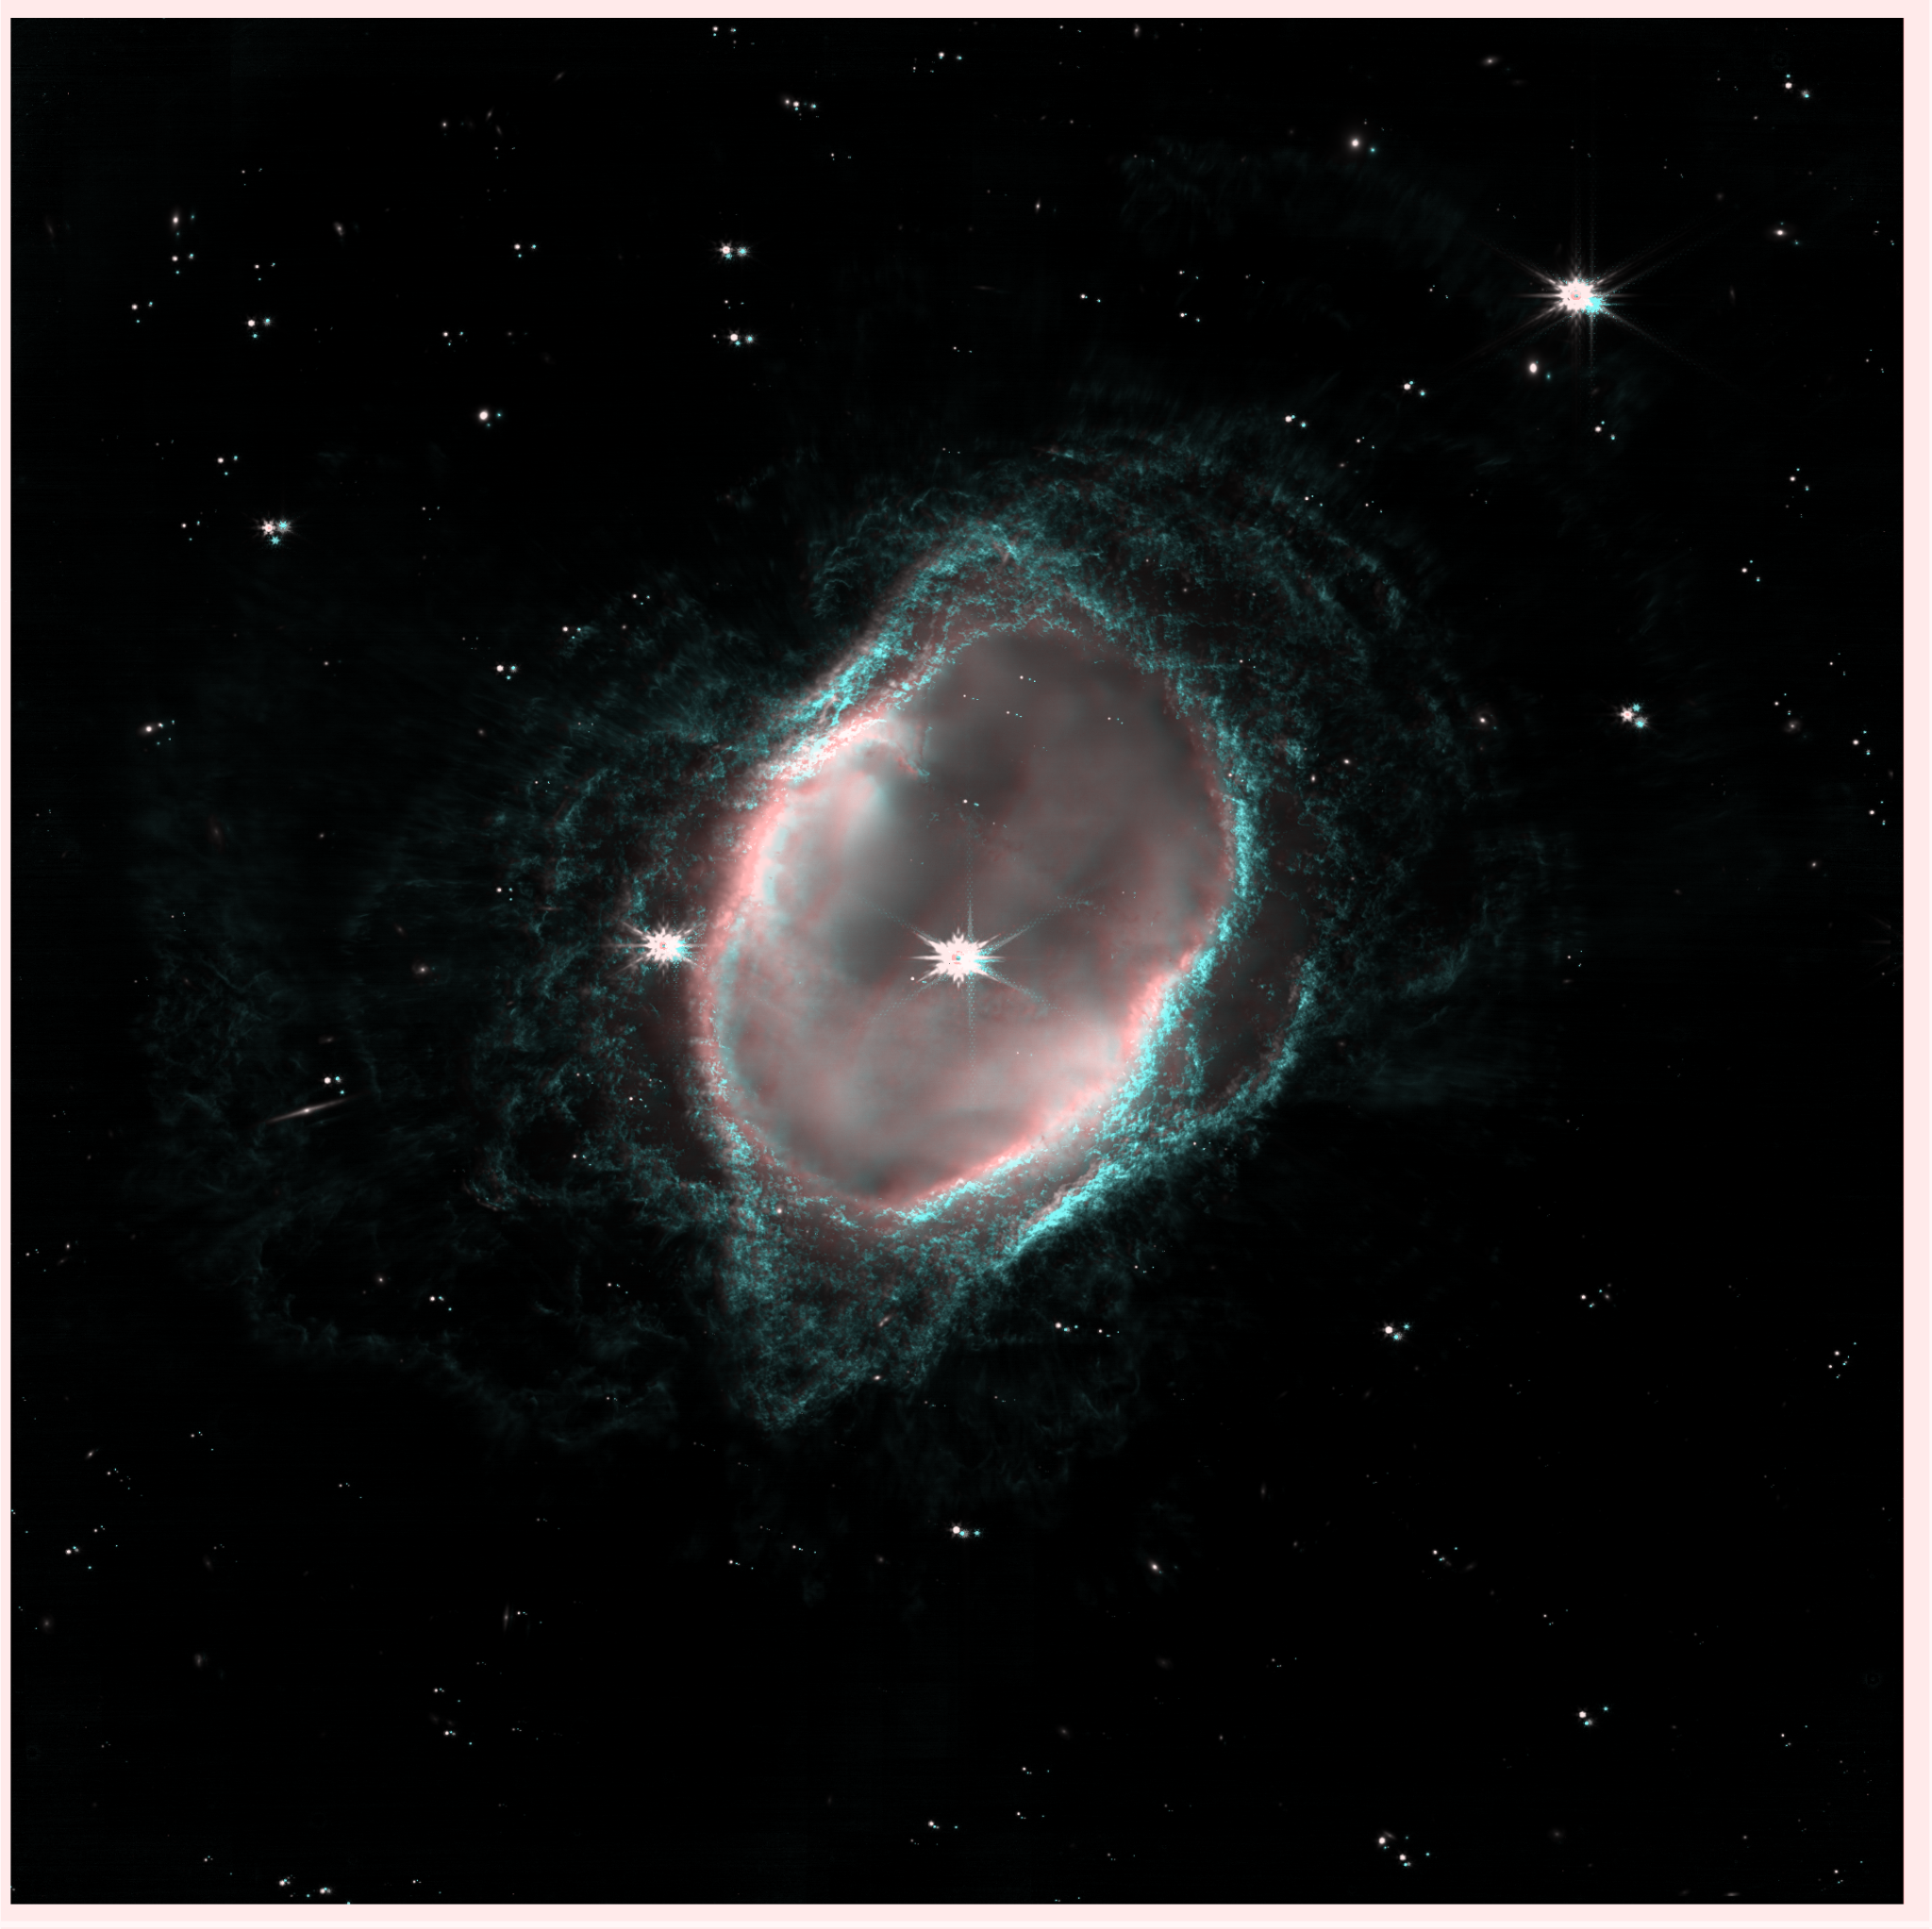
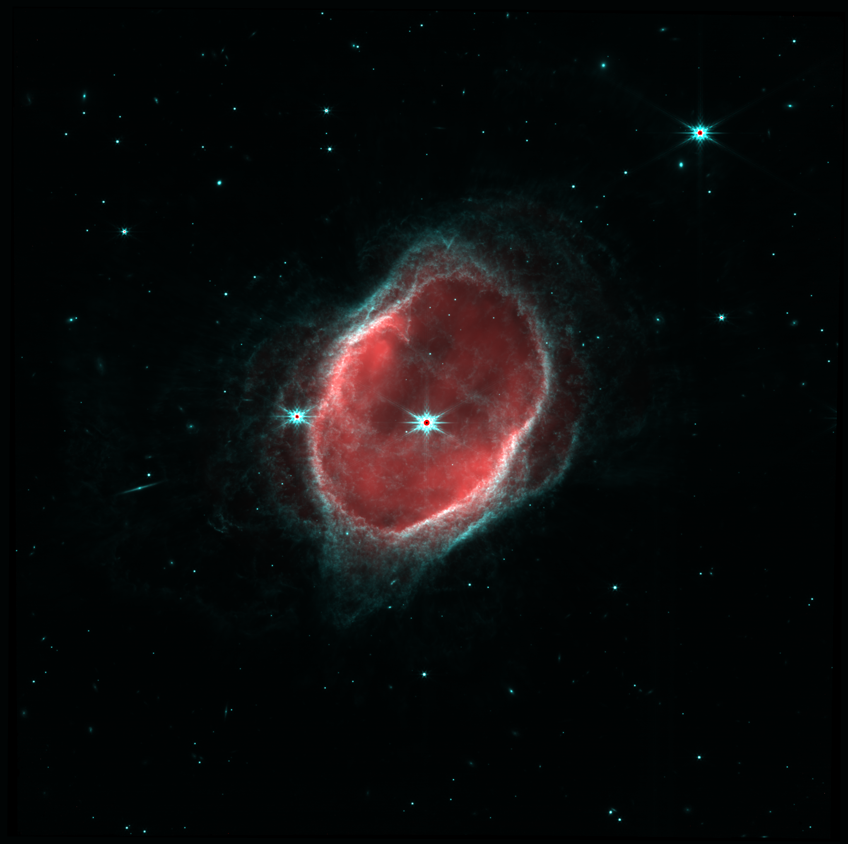
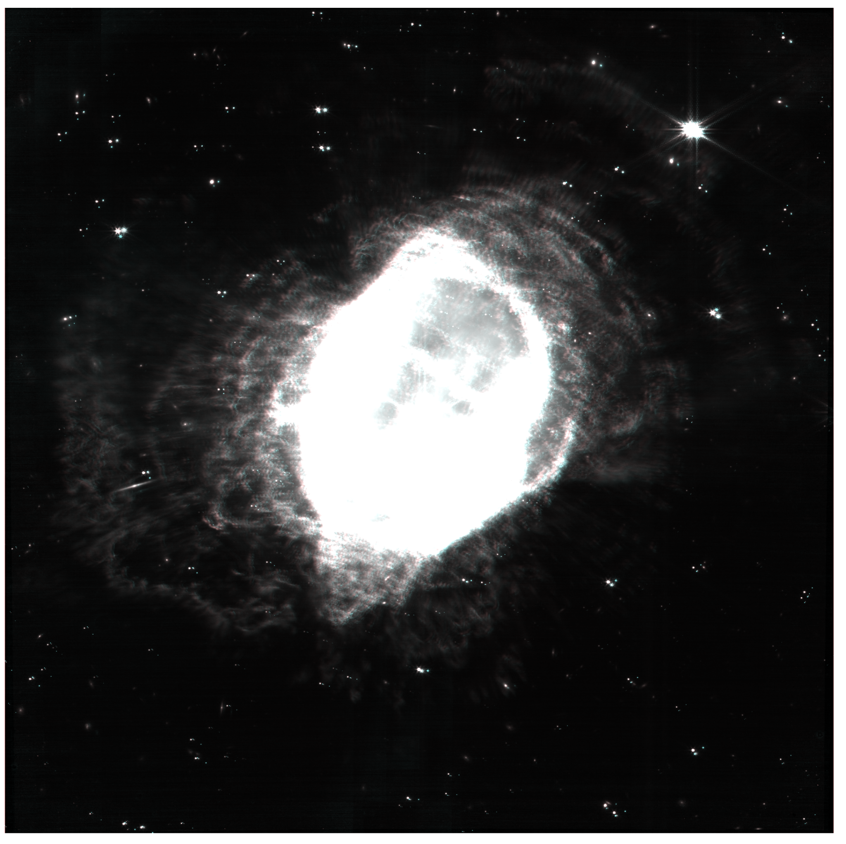
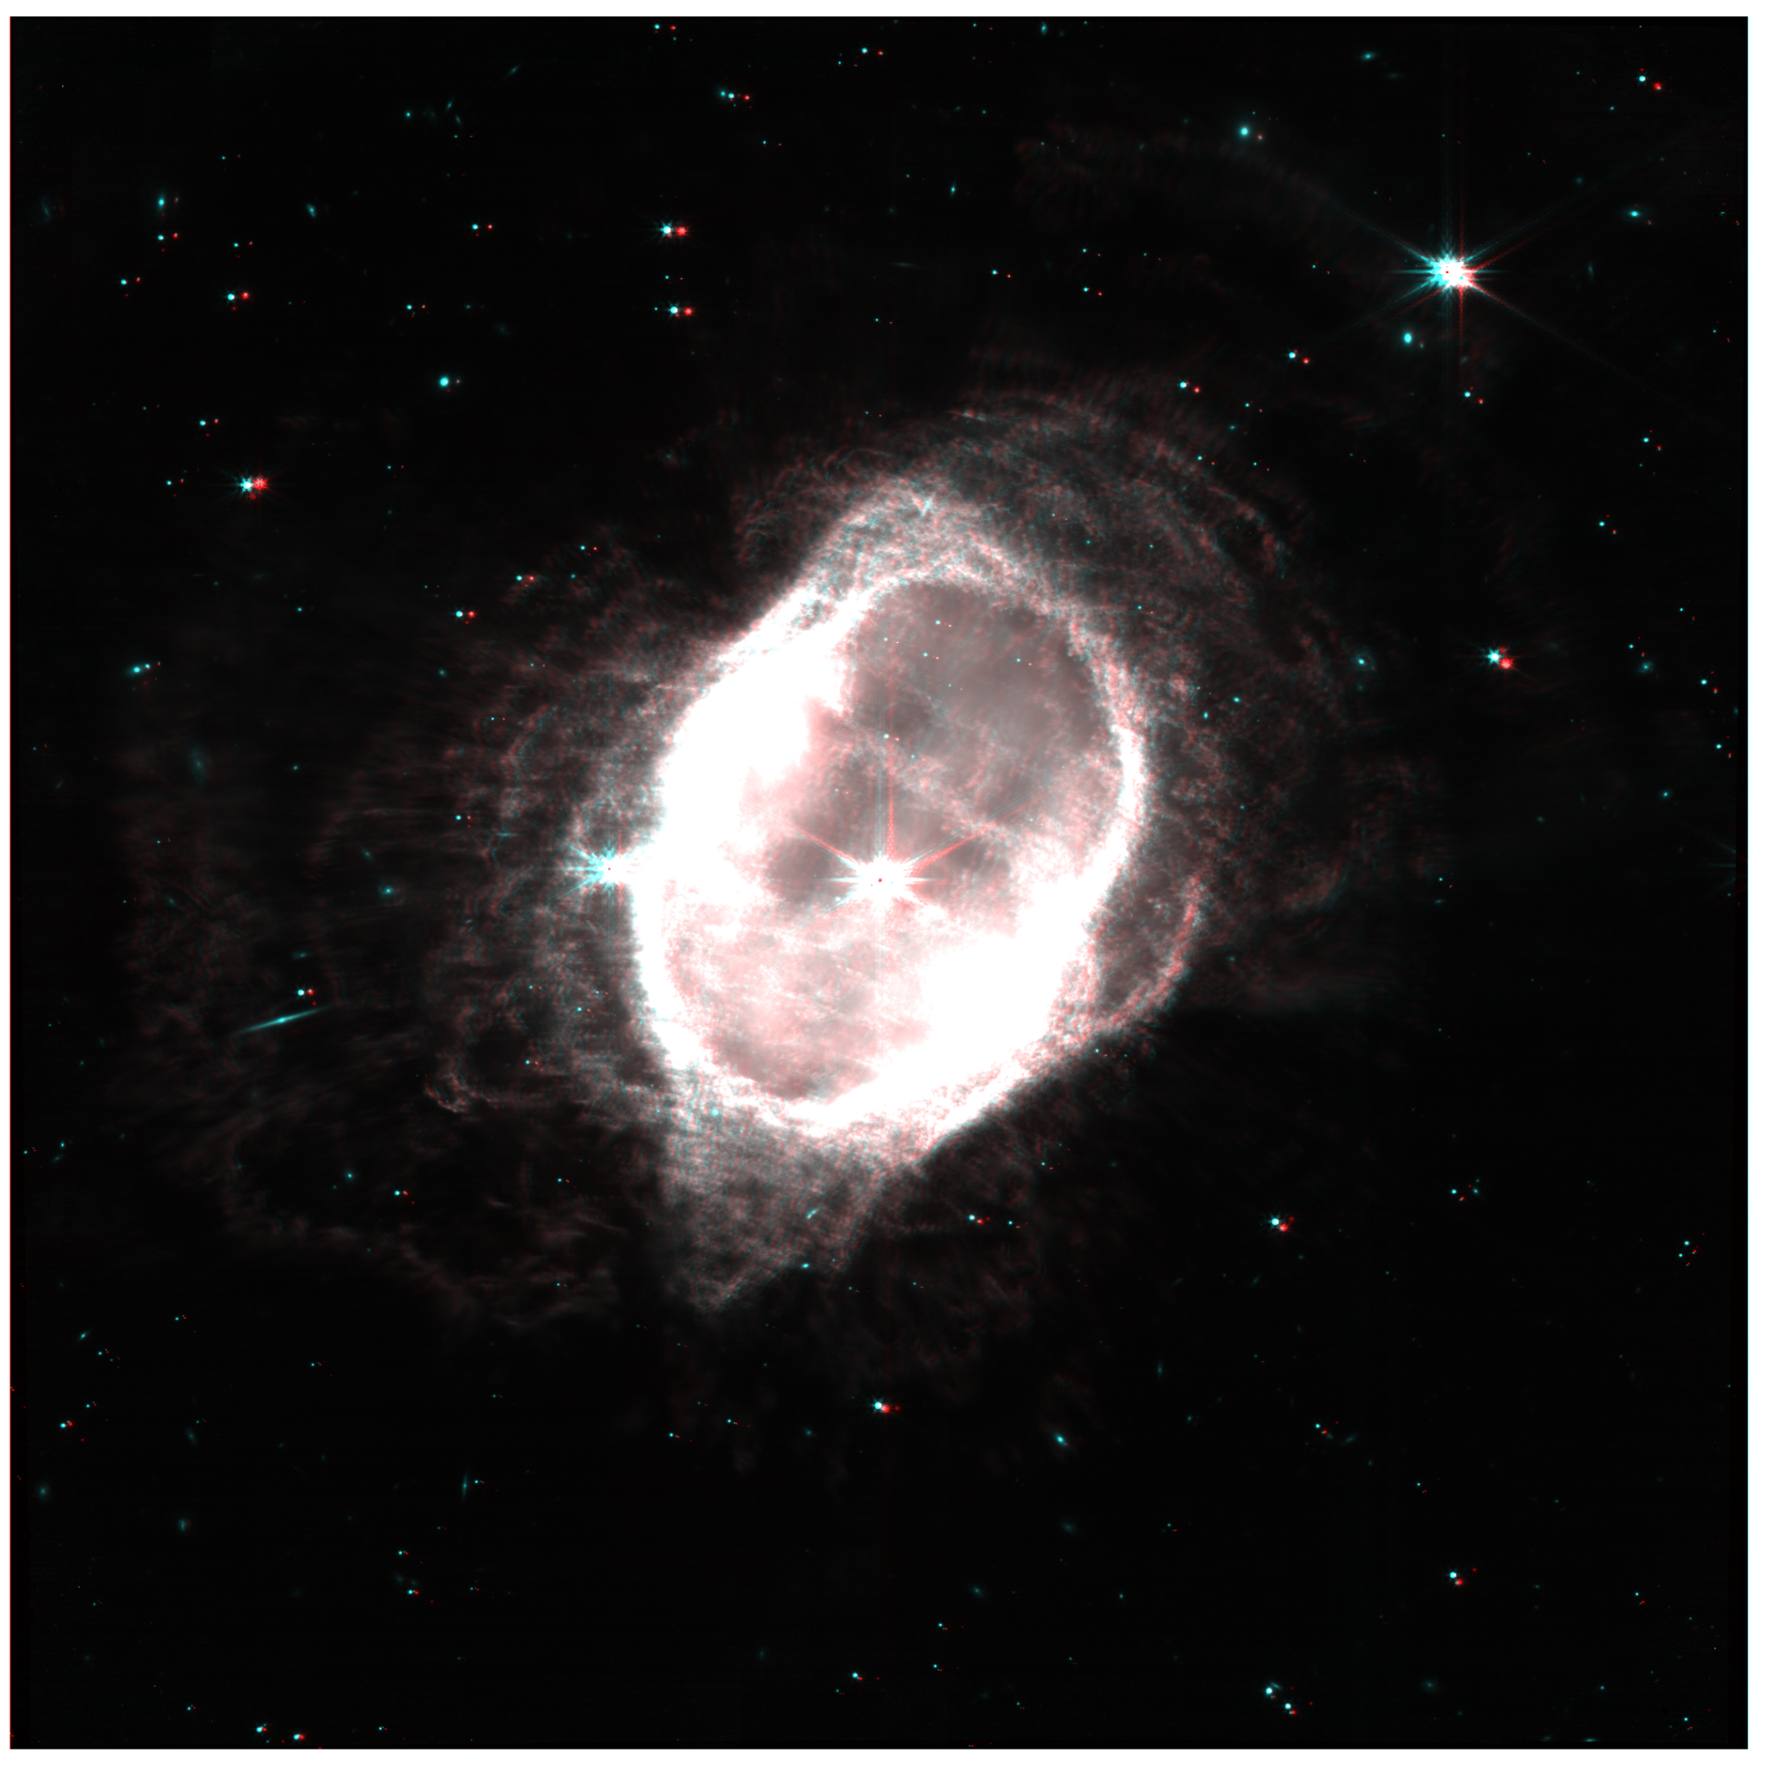
Final results of bad alignments and bad blending modes

Slide 35
Image Data
All data can be found on the MAST Archive, alongside data from any other sources
JWST data has 4 processing stages:
Raw FITS Files (Stage 0): Raw spacecraft output packaged to FITS file format
Detector Corrected Exposures (Stage 1): Output count-rate images after applied detector-level corrections to raw data
Flux Calibrated Exposures (Stage 2): Fully-calibrated individual exposures, and associated files, to all imaging/spectroscopy data and modes
Calibrated Combined Products + Associations (Stage 3): Combined final data products specific to each observing mode

Slide 37
FITS File Format
Used to store astronomical data
One FITS file per filter image
Consists of HDUs (Header + Data units)
Each header unit can contain a table data structure that resembles a dictionary
KEYNAME = value / comment string
Also can contain a data unit
N-dimensional array of one data type (signed, unsigned ints, or floats)
JWST stage 3 data contains several HDUs
Primary: contains no data unit, but has a header unit of records with information about the data capture and processing already completed
SCI: 2-dimensional array that I use as the image for a wavelength capture. Records detailing nearly every detail about that capture
ERR, VAR, others that show error for each pixel value for the SCI table

Slide 38
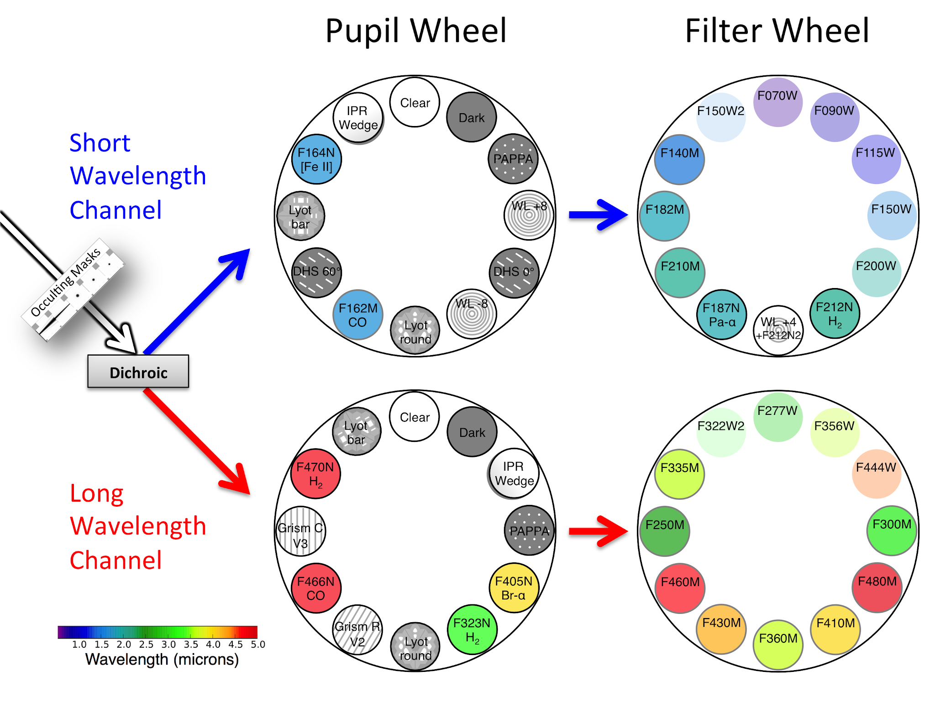
James Webb Space Telescope Pupil and Filter Wheels
Two wheels that can be rotated to allow different combinations of filters

Slide 39
Good Resources
How the composed images are made, and what the raw images look like
https://webbtelescope.org/contents/articles/how-are-webbs-full-color-images-made
NIRCam filters:
https://jwst-docs.stsci.edu/jwst-near-infrared-camera/nircam-instrumentation/nircam-filters

